Slide 1

I-CAN Survivorship Care Updates
Aaron T. Seaman, PhD
November 12, 2025

Slide 2
Survivorship Working Group Recap
May 16, 2025
Participants included administrative staff and clinicians from I-CAN affiliates involved in survivorship care and I-CAN team members
Key points
Affiliates have strong interest in developing survivorship care
Affiliates are already providing services that are part of survivorship care
I-CAN needs to figure out how best to support affiliates in work to build and grow survivorship care services

Slide 3
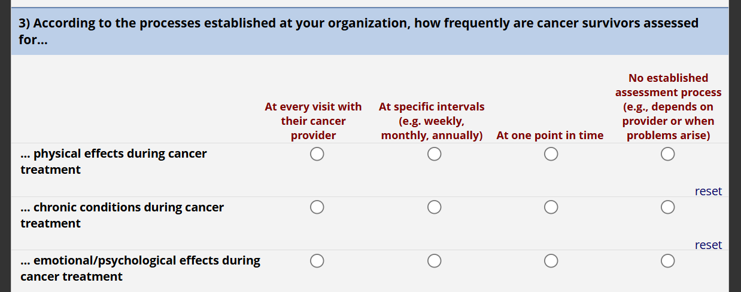
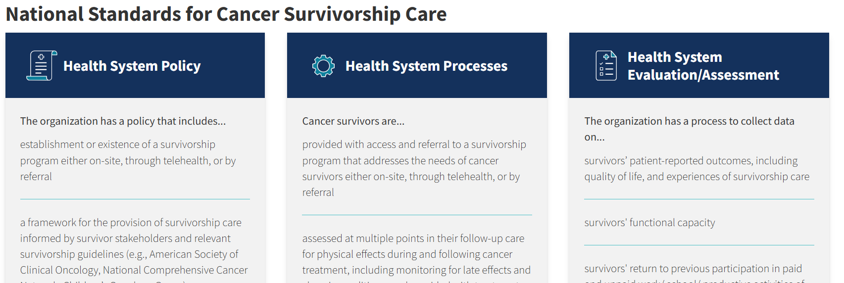
Survivorship Capacity Survey
https://cancercontrol.cancer.gov/ocs/special-focus-areas/national-standards-cancer-survivorship-care

Slide 4
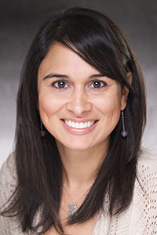
Holden Comprehensive Cancer Center Survivorship Program
Clinical Director of Survivorship
Sneha Phadke, DO
Research Director of Survivorship
TBD
Dedicated Survivorship Clinic
HCCC

Slide 5
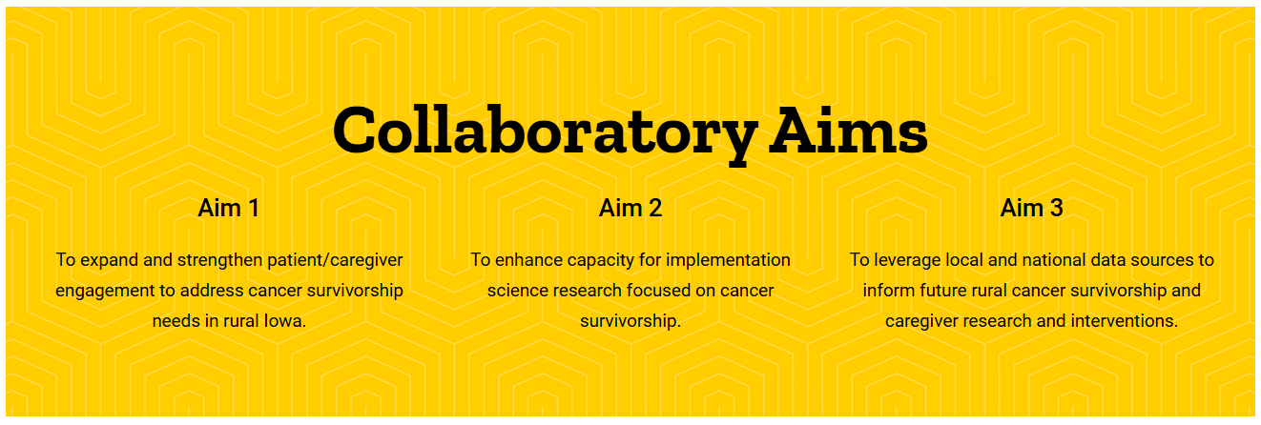
Rural Cancer Survivorship Research Collaboratory

Slide 6
Aim 1:
To expand and strengthen patient/caregiver engagement to address cancer survivorship needs in rural Iowa

Slide 7
Questions?

