Slide 1
Introduction to the CoC Rural Cancer Program Accreditation
Erin Reuter, JD, MS Senior Manager, Accreditation American College of Surgeons Cancer Programs

Slide 2
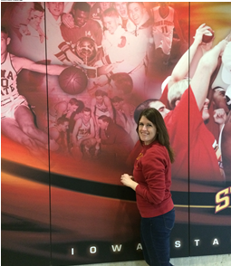

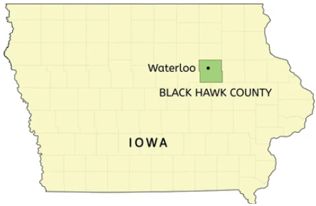
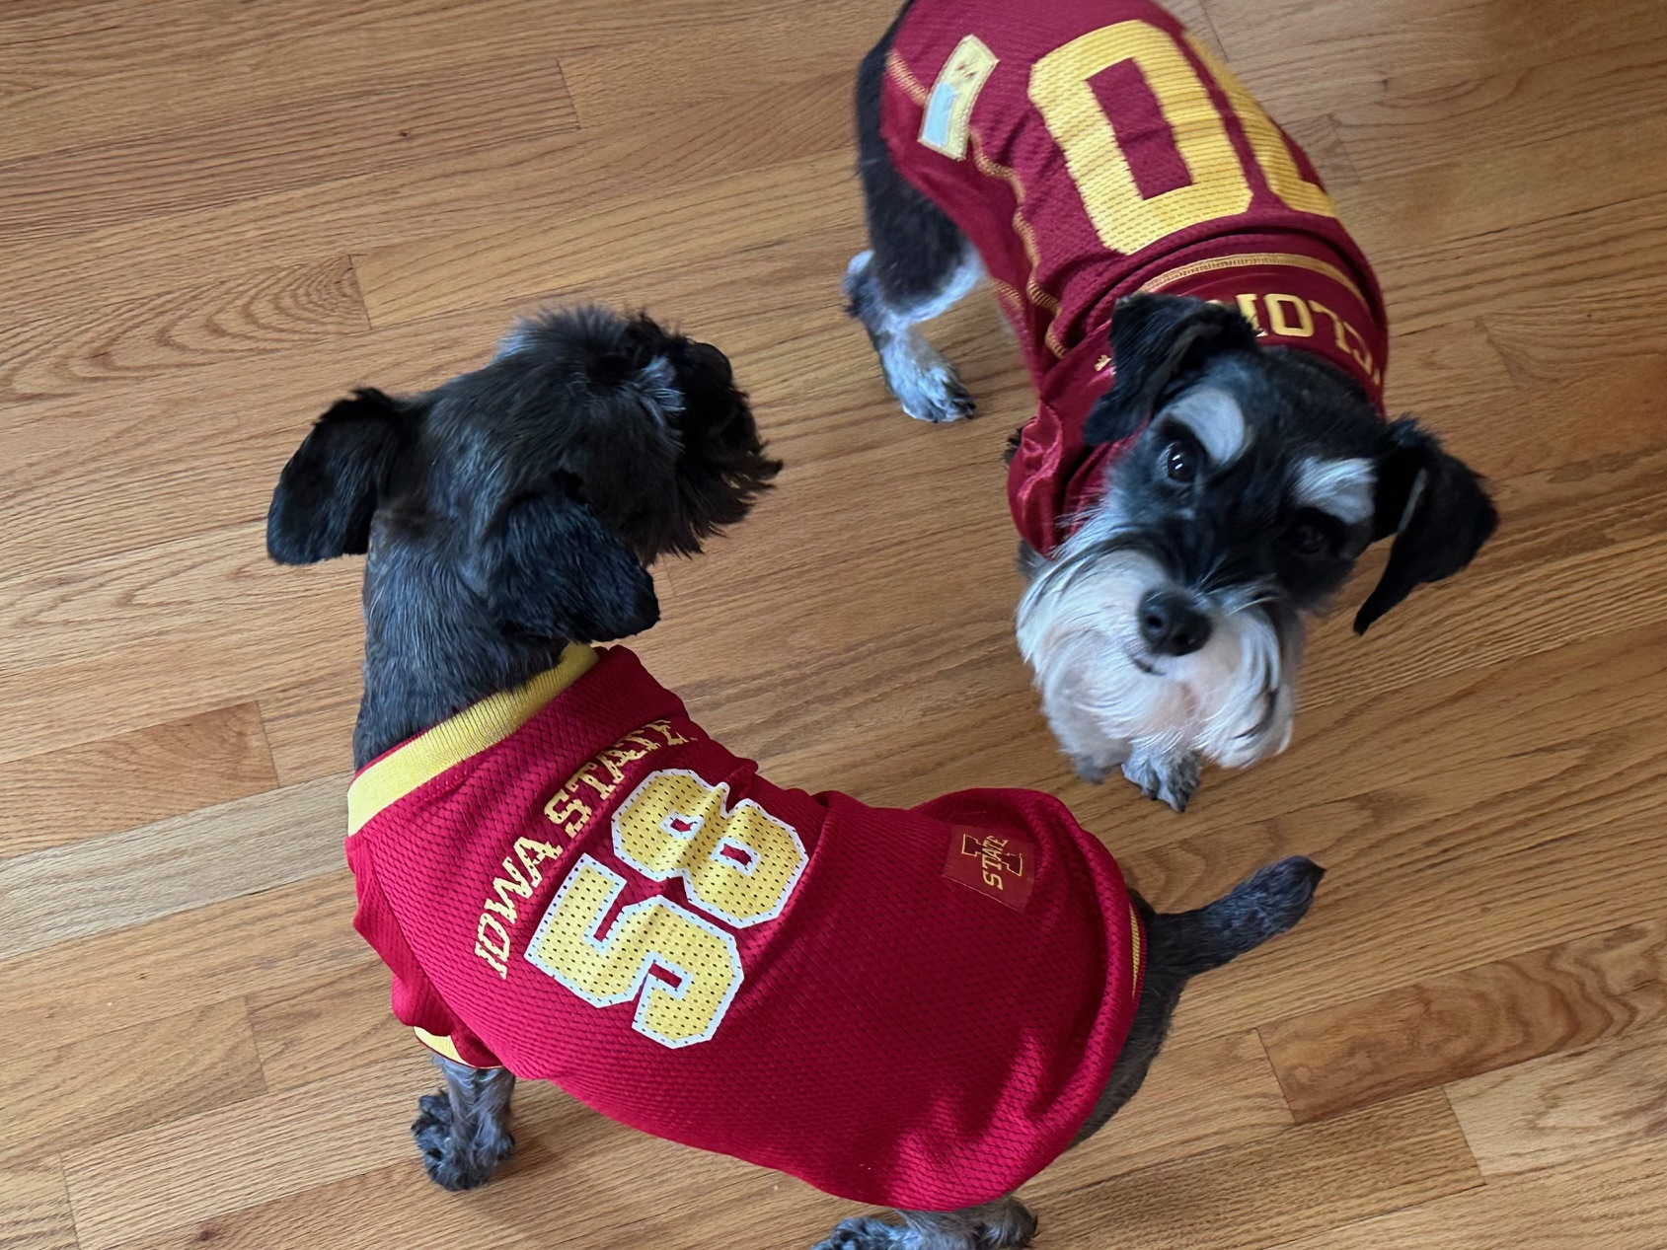
I know Iowa well!
My grandpa at Hilton Coliseum
Waterloo native
Iowa State graduate

Slide 3

Accreditation Committee
Chair: Aaron Bleznak
Vice-Chair: David Mullins
Staff Liaison: Erin Reuter
Advocacy Committee
Chair: James McLoughlin
Staff Liaison: Victoria Hernandez
Committee on Cancer Liaison (CLPs)
Chair: Maria T. Castaldi
Vice-Chair: Quan P. Ly
Staff Liaison: Melissa Leeb
Education Committee
Chair: Bruce Brenner
Vice-Chair: Taryne Imai
Staff Liaison: Asa Carter
Member Organization Steering Committee
Chair: Erica Fischer-Cartlidge
Staff Liaison: Melissa Leeb
Quality Assurance & Data Committee
Chair: Clara Park
Vice-Chair: David Odell
Staff Liaison: Ryan McCabe
Advisory Groups:
• State Chair Recognition
• CLP Education
• Paper Competition
• State Chair & CLP Meeting Planning
Executive Committee
Chair: Laurie Kirstein
Vice-Chair: Dan Boffa
Liaison: Erin Reuter
Program Review Subcommittee
Cancer Programs Site Reviewer Committee

Slide 4



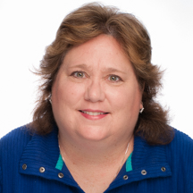




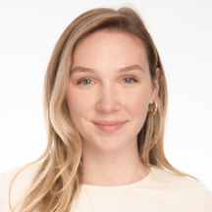

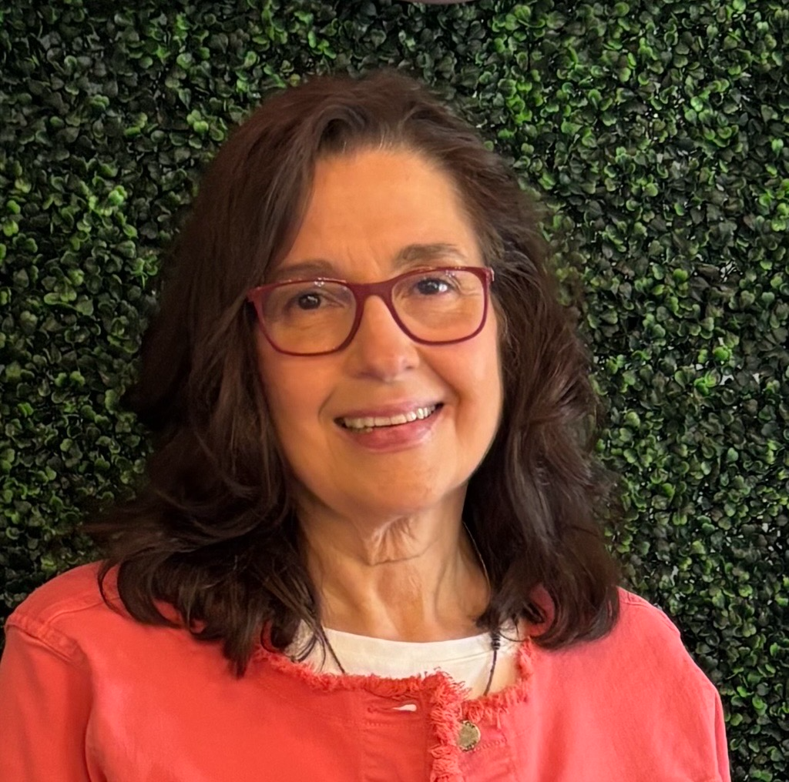
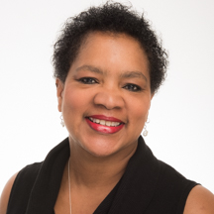
We’re here to help!
Customer Support Team
Quality Assurance Team
CoC@facs.org
NAPBC@facs.org
NAPRC@facs.org
Alana Swanson Mikosz
Manager, Cancer Accreditation Support
Lauren Dyer
Senior Accreditation Specialist
Marci Ramahi
Manager, Cancer Accreditation
Vicki Chiappetta, RHIA, CTR
Senior Accreditation Specialist
Ciara Rounsaville
Coordinator, Cancer Accreditation
Karen Taubert-Boone
Coordinator, Cancer Accreditation
Jacob Schamber
Administrator,
Site Reviewer Training & Development
Manager, Standards Development
Amy Szkorla, MPH
Accreditation Specialist
Kalea Whitmore,
MS, MBA
Accreditation Specialist
Karen Stachon, CPHQ
Senior Accreditation Specialist

Slide 5


Accreditation Tailored to Rural Programs
Eligibility: Hospital is located in a county that is designated RUCC 4-9
RUCC: Metric that differentiates counties by their population size, degree of urbanization, and adjacency to a metro area

Slide 6
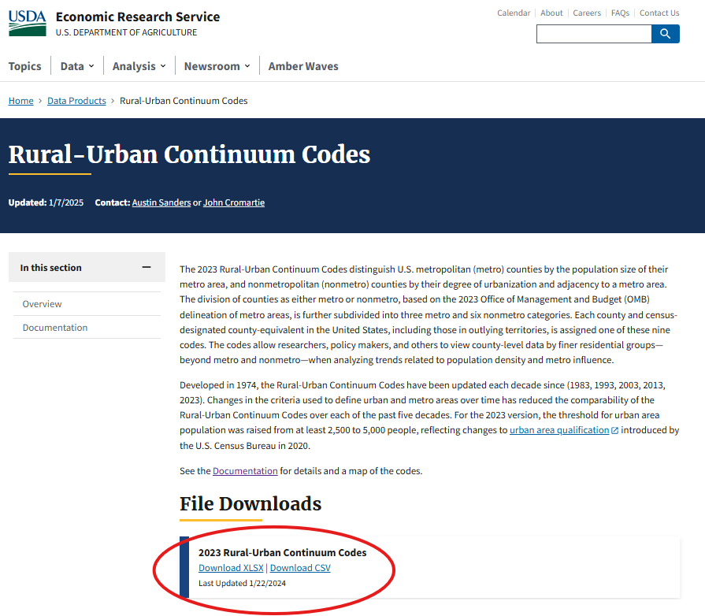
https://www.ers.usda.gov/data-products/rural-urban-continuum-codes

Slide 7
All counties in Iowa qualify, except….
Benton
Black Hawk
Boone
Bremer
Dallas
Dubuque
Grundy
Gutherie
Harrison
Jasper
Johnson
Jones
Linn
Madison
Mills
Polk
Pottawattamie
Scott
Story
Warren
Washington
Woodbury
Notes:
77 counties qualify

Slide 8
Rural Taskforce Members
Rural Taskforce Members
Ingrid Lizarraga, MBBS, FACS | Surgeon | Iowa City, IA
David Welsh, MD, MBA, FACS | Surgeon | Batesville, IN
Mary Charlton, PhD | Researcher | Iowa City, IA
Charles Shelton, MD | Radiation Oncologist | Nags Head, NC
Michael Sarap, MD, FACS | Surgeon | Cambridge, OH
David Mullins, MD, FACS | Surgeon | Princeton, WV
Cliff Connery, MD, FACS | Surgeon | Westport, NY
Liz Marshall, RHIA, ODS-C, CCS | Oncology Data Specialist | Cheyenne, WY
Sheryl Greer, ODS-C | Oncology Data Specialist | Sequim, WA
John Montville | Administrator | Paducah, KY
Ron Weigel, MD, FACS | Surgeon | Iowa City, IA

Slide 9

You too!
Thank you!

Slide 10
How’d we come up with the standards?
Evaluated Current CoC Standards
Developed first draft of modifications based on feedback from rural hospitals
(IA & KY)
Created rural taskforce & vetted modifications
Gathered feedback

Slide 11
This is happening soon!*
Dec 2025
Rural Cancer Program Standards Released
2026
Program complies standards
Fall 2026
Application open for rural accreditation track
*Subject to Change

Slide 12
What’s different in the Rural Track?

Slide 13
Fewer requirements to apply
Exempt at initial site visit:
Tumor Board*
Quality Improvement Initiative
Barriers to Care
Only need to offer 1 of 3 supportive care services at initial site visit:
4.5 Palliative Care
4.7 Nutrition
5.2 Psychosocial distress screening

Slide 14

Decreased staffing requirements
Current Requirements:
Must have a cancer committee with the following specialties: radiology, pathology, surgery, medical oncology, radiation oncology, nursing, social work, and Oncology Data Specialist
Must have a CLP, Cancer Committee Chair, Cancer Program Administrator, and representatives filling six coordinator positions
Modified RCP Requirements:
Must have a cancer committee with three physicians and two healthcare professionals (all from different disciplines)
Additionally, required to have CLP, Cancer Program Administrator, and three coordinator positions

Slide 15

Decreased tracking and documentation requirements
Reports only required once per 3-year accreditation cycle instead of annually for:
Monitoring concordance with EBG
No requirement for tracking of number of patients referred for:
Genetic Counseling, Palliative Care, Nutrition, Psychosocial Distress Screening, Survivorship, Clinical trials
Only one QI project required per accreditation cycle
Only one survivorship program needs to be reviewed per year (vs 3)

Slide 16
Standard 4.4: Genetic Counseling and Risk Assessment
Current Requirements:
Risk assessment, genetic counseling/testing provided either on-site or by referral by qualified genetics professional
Policy in procedure in place
Process in place to pursuant to evidence-based guidelines for specific cancer site.
In-depth review of a specific cancer site
Modified RCP Requirements:
No data review for a specific cancer site
Annual review limited to monitoring, evaluating, and making recommendations for improvement to genetics

Slide 17


Decreased requirement for patient services
Standard 4.5: Palliative Care Services, Standard 4.7: Oncology Nutrition Services, and Standard 5.2: Psychosocial Distress Screening
Before the initial site visit, the Rural Cancer Program complies with one of the following standards: 4.5, 4.7, or 5.2.
By the reaccreditation visit, the Rural Cancer Program must comply with at least two of the following standards: 4.5, 4.7, or 5.2.
The required annual review is limited to monitoring, evaluating, and making recommendations for improvements.

Slide 18
Key standards that remain the same
Data submission requirements
Compliance with Quality Measures
Operative Standards
Pathology Reporting
Smoking Cessation
Prevention and Screening Events
Tumor Board (but only after initial site visit)
Cancer Liaison Physician

Slide 19
Continuous Cycle of Evaluating Standards
Expert panel evaluates research and best practices
Develops achievable accreditation standards
Releases accreditation standards to focus groups and/or public comment
Implements accreditation standards
Monitors compliance through site visits by trained physician reviewers
The continuous monitoring process focuses on identifying when standards may need to be revised, sunset, or added due to:
New or changing evidence
Consistent pattern of high compliance over a sustained period
Consistent challenges with compliance due to feasibility

Slide 20
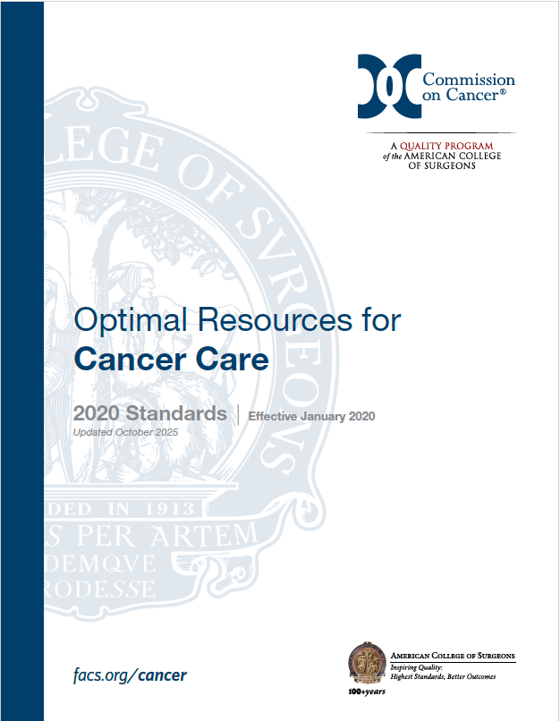
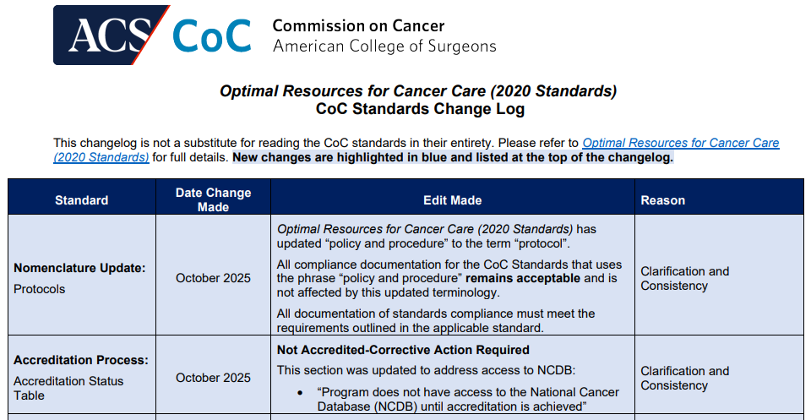
How often do standards change?
Current iteration released in October 2019
Updates have been made ~2x/year since—usually minor
(Very) detailed change log available to track changes

Slide 21





Slide 22
Updated! Changes in Operative Standards (5.3-5.6) Assessment
Current State
Standard evaluated solely on Site Reviewer audit of operative report
Evaluated once every three years
New Process
Cancer Program performs annual audit for Standard 5.3-5.6
Compliance met by either audit results that meet/exceed 80% OR through a detailed action plan
Does not apply to
Standard 5.7: Total Mesorectal Excision
Standard 5.8: Pulmonary Resection

Slide 23
All Programs: Requirements during 2026
Programs must perform an audit of 30 cases (or all applicable cases) of eligible cases. For each case, the audit must assess:
All required elements are present in the operative report in synoptic format
Responses to the required elements are appropriate
All elements of the audit are recorded in the CoC audit template
Audit results must be reported and discussed with the cancer committee each year AND documented in the minutes

Slide 24


Standard 5.3-5.6: Standard Compliance
If the audit demonstrates that all requirements are met in 80% or more cases, no further action is needed
If audit demonstrates less than 80% compliance, then a meaningful action plan must be developed
Requires a second audit within 6 months to determine impact of intervention
Consecutive action plans without new/additional action will result in deficiency

Slide 25
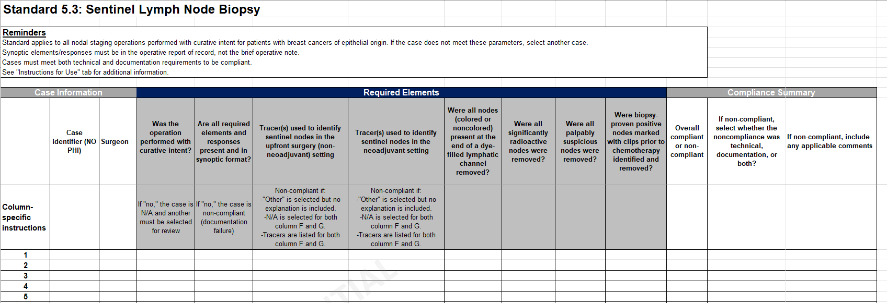
Example of CoC Audit Template
Audit templates provided that facilitate consistent application across cancer programs

Slide 26
NEW! Standard 5.9: Smoking Cessation for Patients with Cancer
Audit Requirements
Each year, cancer committee must conduct an internal audit of a minimum of 20 patients with newly diagnosed cancer to determine:
# screened
# who reported current smoking
# who reported smoking and received/were referred for smoking cessation treatment
Action plan required if audit shows:
Less than 90% of patients were screened for smoking status
Less than 80% of current smokers were referred for treatment
Process Requirements
Must implement process to screen for smoking status in patients with newly diagnosed cancer at initial consultation at accredited program for cancer treatment
Referrals must receive or be referred for smoking cessation treatment consistent with evidence-based guidelines.
Services must be available on-site or by referral

Slide 27
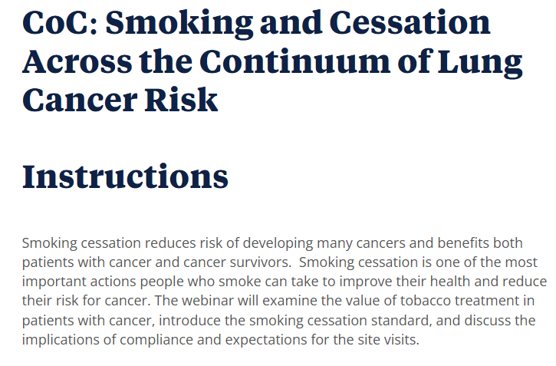


Free Smoking Cessation Webinar Available!

Slide 28
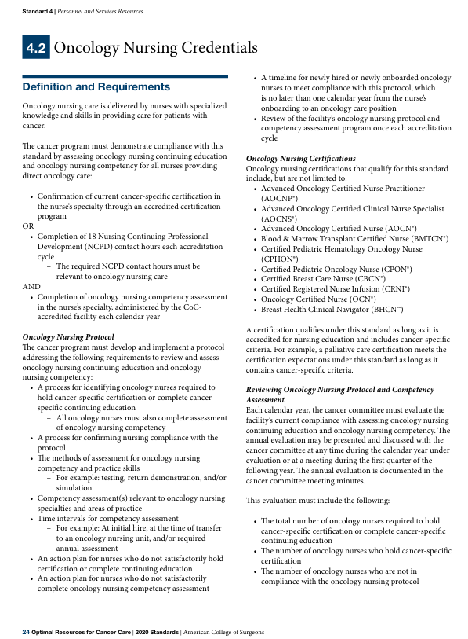
Updated! Standard 4.2: Oncology Nursing Credentials
Education:
Oncology nursing certification or
Completion of 18 oncology nursing education credits
External review changed to Internal tracking
Annual Competency:
Increased specifics outlined for annual oncology competency assessments
ROBUST
Action plan can be used for 2026 site visits if not meeting requirements

Slide 29
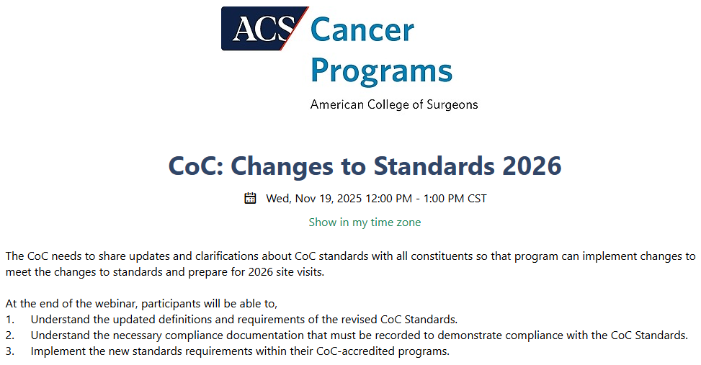
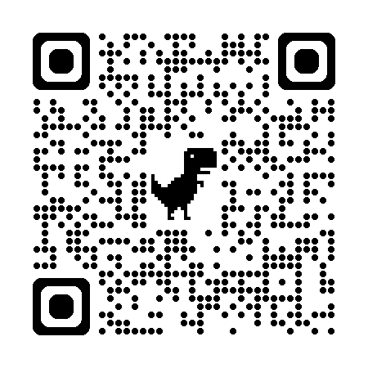
Webinar Opportunity!

Slide 30
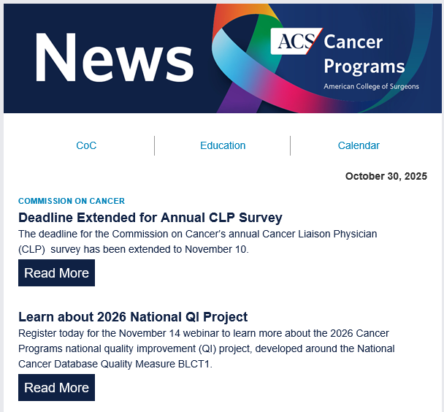
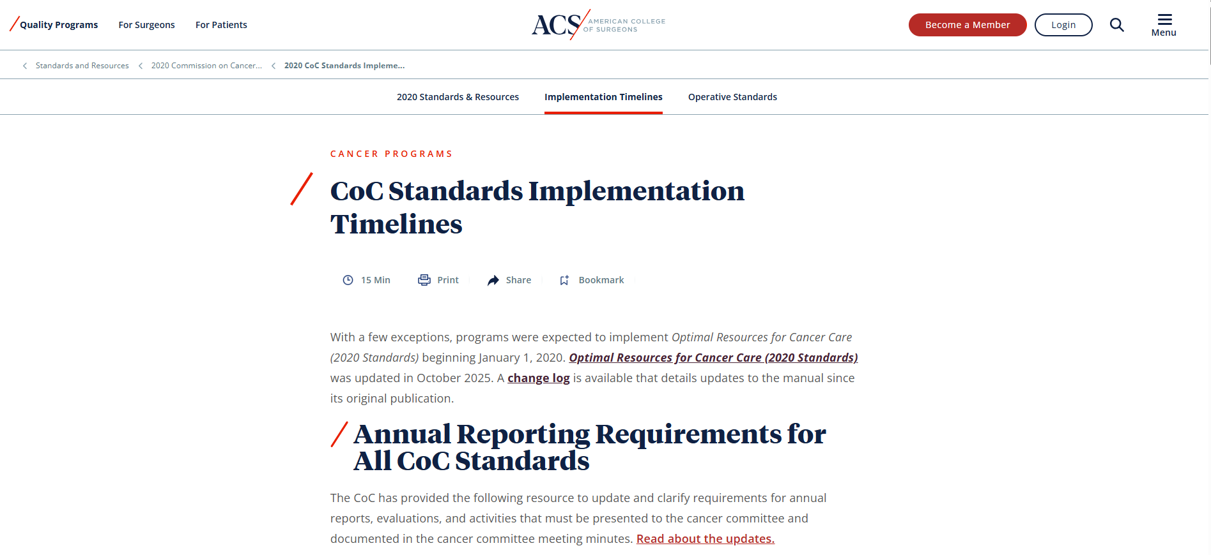
How to Learn About Changes
Cancer Programs e-newsletter
Comes out every other Thursday
CoC Implementation Website
Updated with substantive changes

Slide 31


Go Cyclones!

