Slide 1
Maximizing Your Accreditation Experience:
How to Prepare and Avoid These Common Pitfalls
Karen Stachon, CPHQ
Kalea Whitmore, MBA, BS

Slide 2
Disclosures
None

Slide 3
Objectives
Review expectations and preparation for accreditation.
Describe the new application process and the resources available to help with preparation and expectations for programs interested in pursuing accreditation.
Discuss best practices that can be implemented during the initial site visit for accreditation and the renewal accreditation process.
Identify common pitfalls and learn ways to avoid them for a successful site visit.

Slide 4
Preparing for Accreditation
Accreditation Policies and Processes

Slide 5
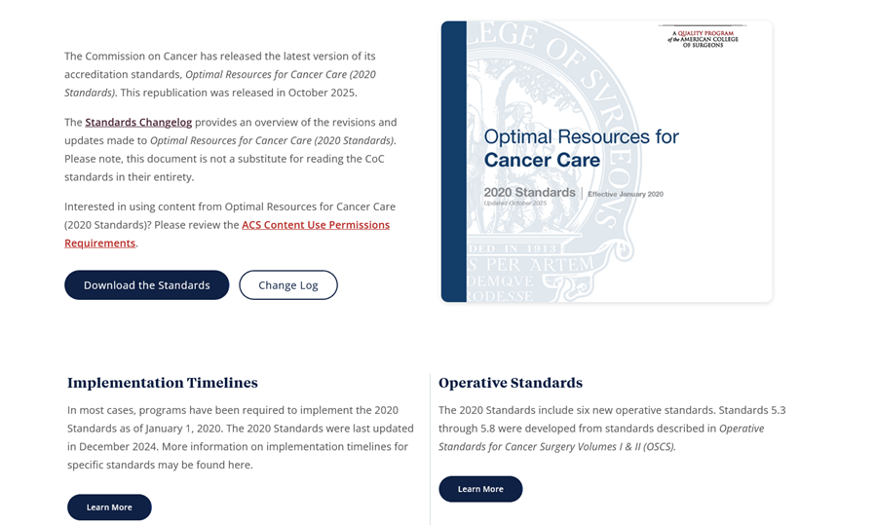
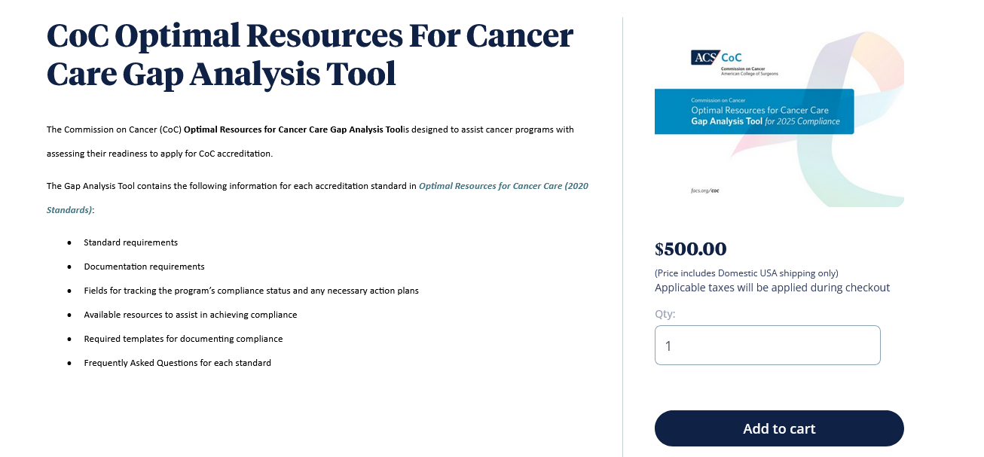
Preparing for Accreditation
Preparation Resources
Optimal Resources for Cancer Care Standards Manual (2020 Standards) *Updated October 2025
Standards Change Log
CoC Standards Implementation Timelines
CoC Optimal Resources for Cancer Care Gap Analysis Tool
CAnswer Forum
Educational Webinars and Conference Materials

Slide 6
The Application Process
Full calendar year of compliance
Establish a cancer registry start date, collect one year of data, and conduct one year of patient follow-up
Key application dates and information
New program checklist
Pre-submission
Submission
Post-submission
Submit applications by June 30th
Complete a Business Associate and Data Use Agreement (BA/DUA)
Initial accreditation fee payment
Receive full access to the Quality Portal (QPort) and Pre-Review Questionnaire (PRQ)
Submit four preferred dates for site visit
Undergo in-person site visit

Slide 7
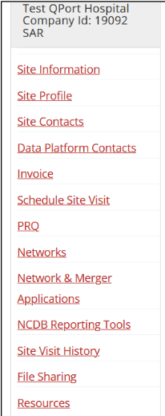
Quality Portal (QPort)
Accreditation management portal for cancer program activity
Username and password
Accreditation tools and templates
QPort is accessible at: https://qualityportal.facs.org/qport
Protected Health Information (PHI), including redacted medical records, should not be uploaded to any section of QPort.

Slide 8
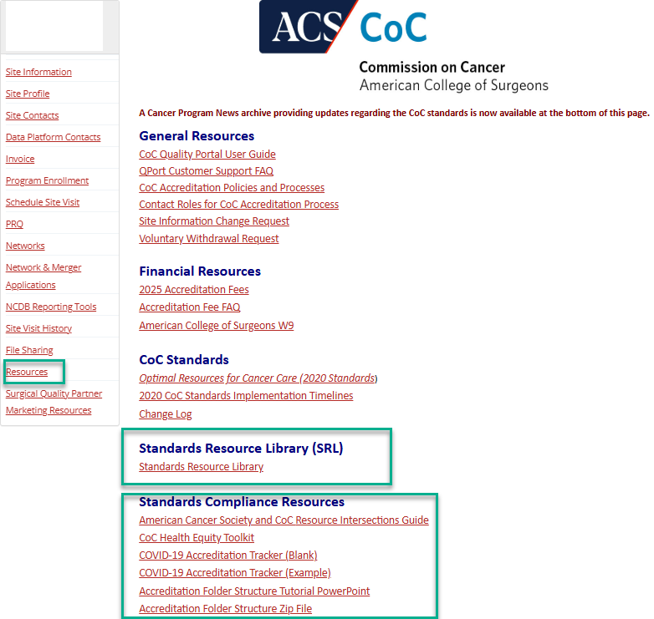
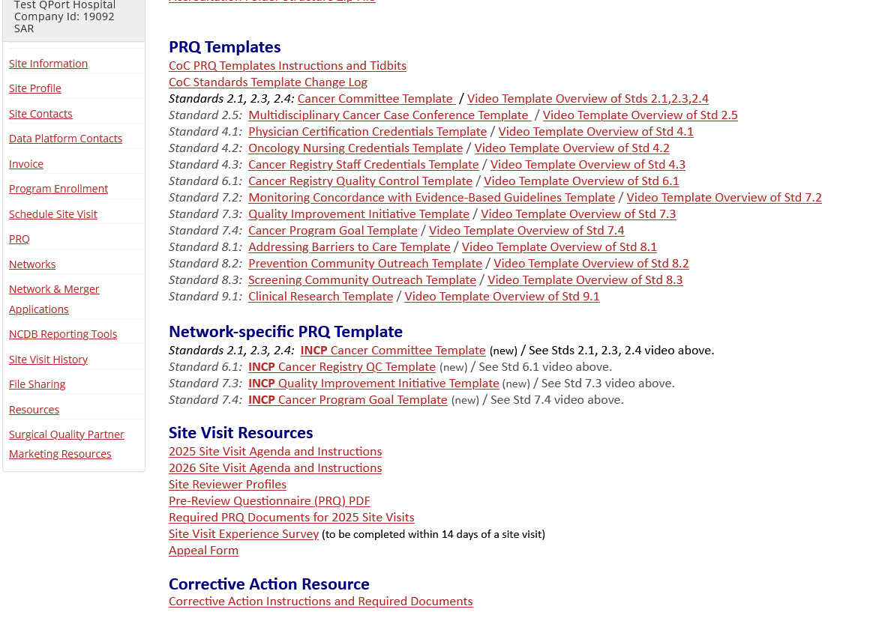
Available Resources in QPort
Standards Resource Library
FAQs
Tips
Sample documentation
Compliance Resources
Site Visit Resources
Templates
Corrective Action Resource
Notes:
QPort Resources
SRL –
Refer to CC Minutes samples (S2.3)
SMART Format for Goals

Slide 9
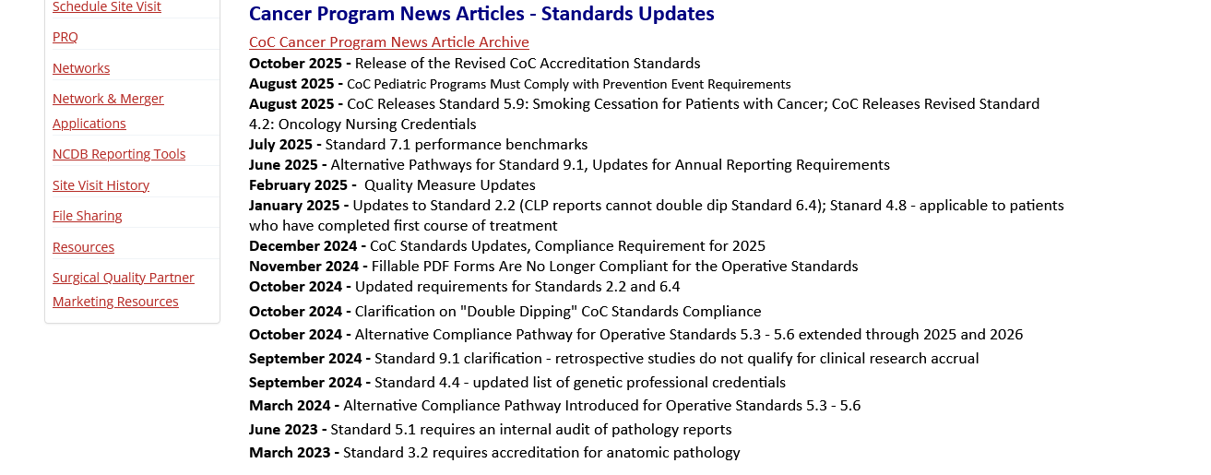

Available Resources
Cancer Program News
Twice a month
Includes articles with the latest news and updates from all ACS Cancer Programs
CAnswer Forum
Interactive, virtual bulletin board
Individual user access
Specific Forums
Chapters
Standards
Notes:
The Cancer Program News is sent twice per month. By clicking on the Cancer Program News Article Archive for each program, you can view the articles pertaining to the specific program. There is also a direct link to the subscription page where you can get signed up to receive the CPN every other Thursday. While some are referenced here, be sure to read the full Cancer Program News.
The CF is a great tool. If you are not already registered, you can review the instructions for accessing and signing up to become a member. There is no fee, you do not have to be from an accredited program to utilize the site. In addition to information by Program and Standards Manuals, there are Forums for AJCC TNM Staging by Version/Edition, the STORE Manual, Rapid Cancer Reporting System and Ask the Pathologist, which is responded to by CAP members.

Slide 10
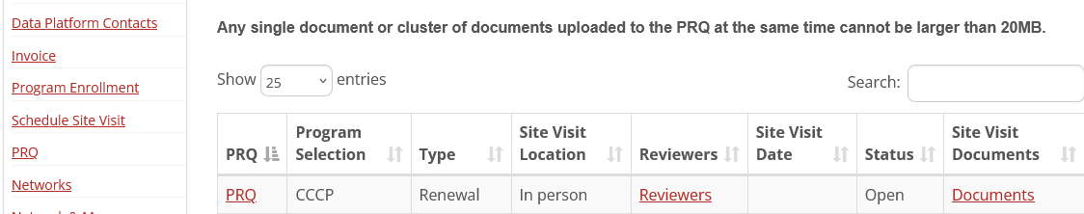
Pre-Review Questionnaire (PRQ)
Provides necessary information and documentation for Site Reviewers to assess compliance with the standards
Available to programs beginning in the Fall before the year of the site visit.
Accessed by programs in QPort.
Completed at least 60 days before the confirmed site visit date.

Slide 11
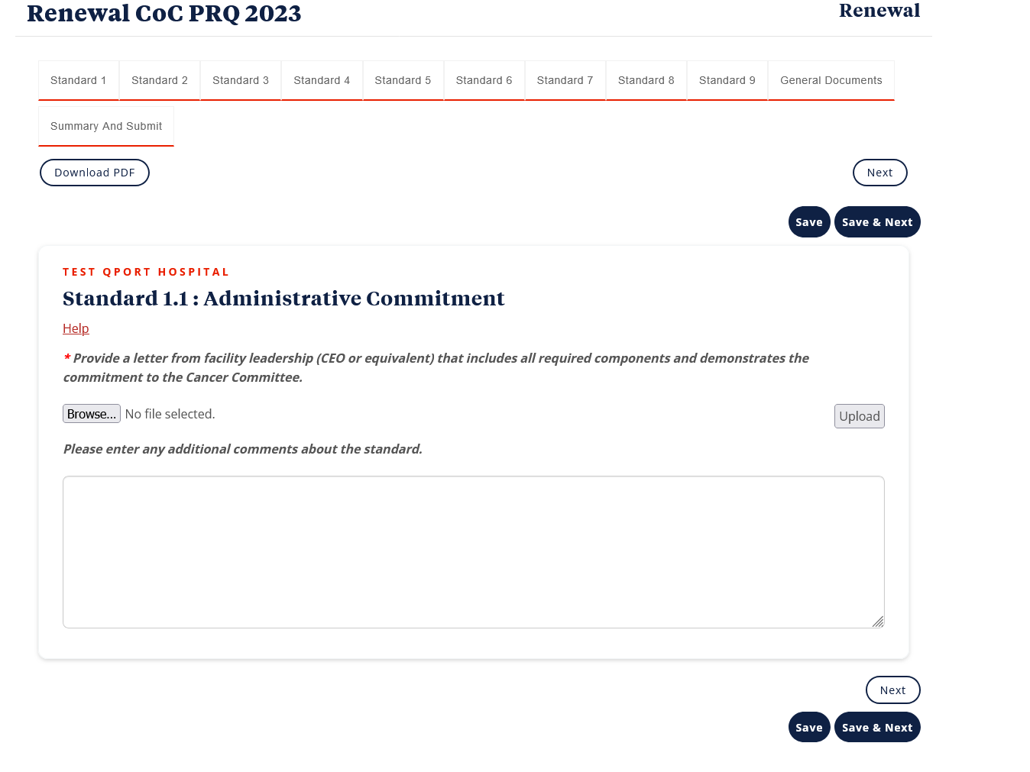
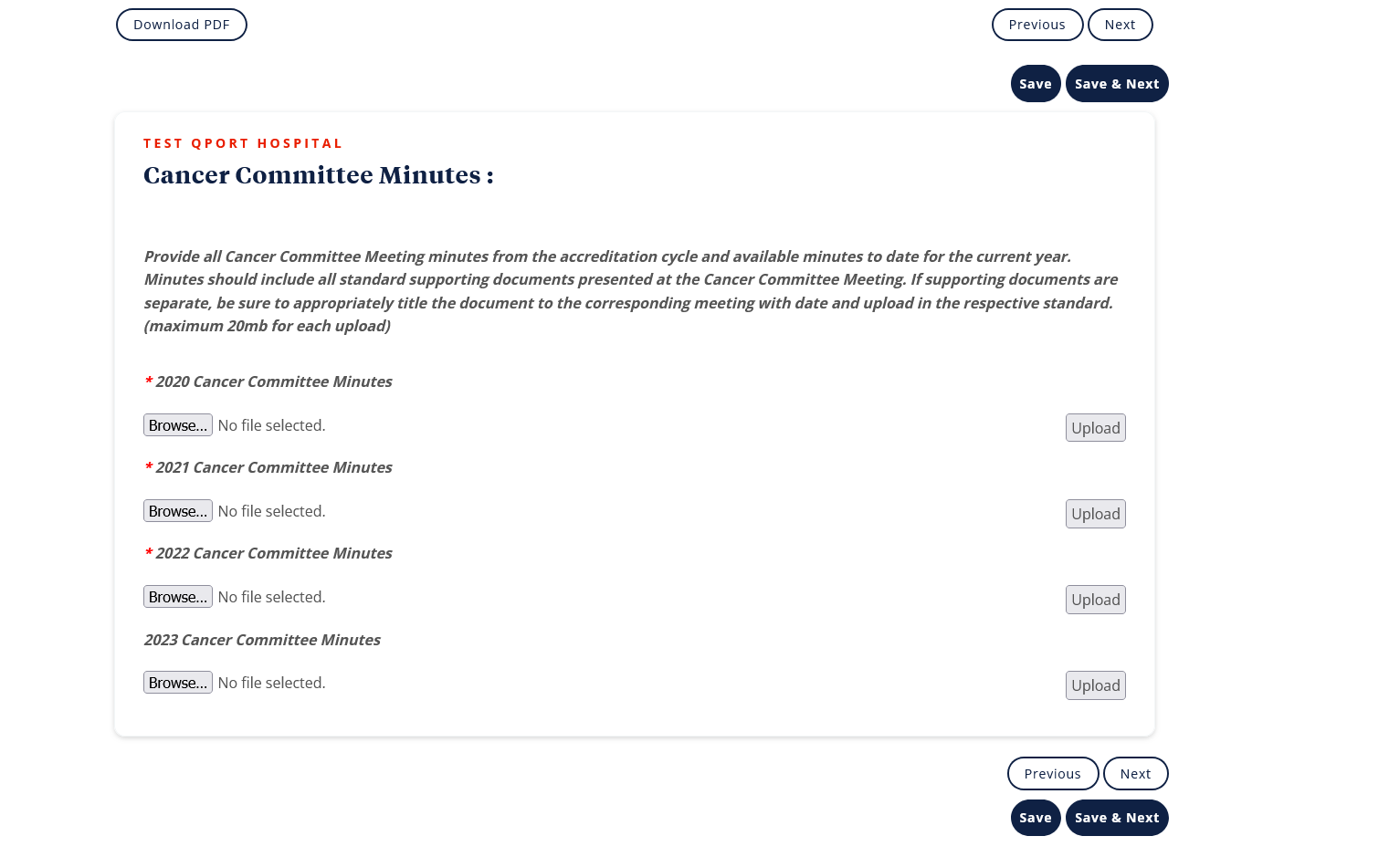
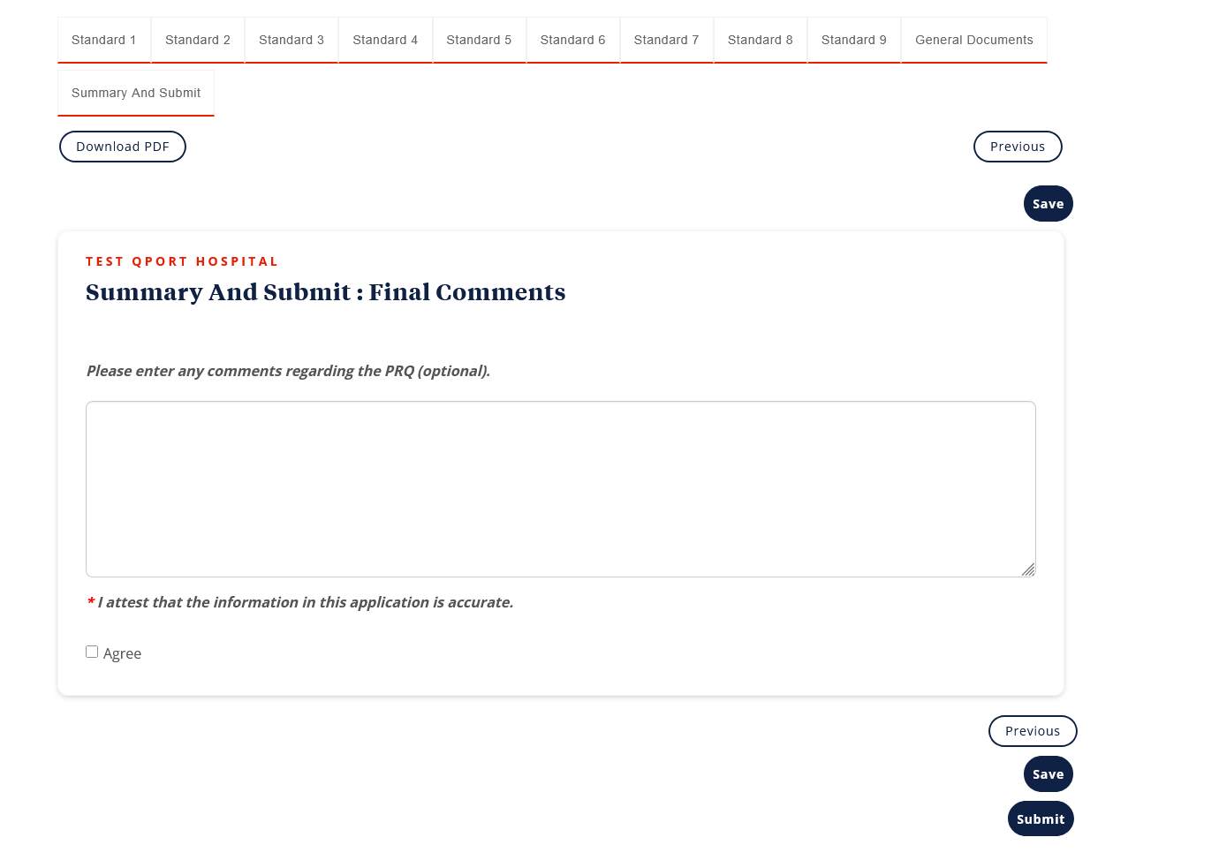
Pre-Review Questionnaire (PRQ)

Slide 12

Protected Health Information
Reminder: Protected Health Information (PHI) should NOT be included in any documentation uploaded to the Quality Portal or PRQ
• Patient names, including initials
• Medical record numbers
• Social security numbers
• Treatment dates
• All other patient identifiers

Slide 13
The Initial Site Visit
In-person site visit
Specifications by Category (Standards Manual)
Site Visit Agenda and Instructions
Program responsibilities
Medical record review process
Submit data to the National Cancer Database (NCDB) after receiving Accredited status
Non-compliant standards and corrective action
Promote your accreditation

Slide 14
Rapid Cancer Reporting System (RCRS)
Single source of data submission for all CoC-accredited hospital registries.
Monthly submissions
Begins within 30 days of the notification of Accredited status
RCRS “Next Steps” document provided with the Accreditation Report
Access to RCRS
What years should be submitted
Available resources

Slide 15
Documenting Program Performance
Supports compliance with the standard
Provides a record of important information and cancer program activity
Allows the site reviewer to verify the accuracy and completeness of your cancer program activity
Helps the cancer committee stay organized and on track
Provides clear information, minimizing errors and misunderstandings
Ensures the cancer program and cancer committee maintains accountability
Notes:
Must be in the minutes and on the Templates as required.
Refer to SRL at S2.3

Slide 16
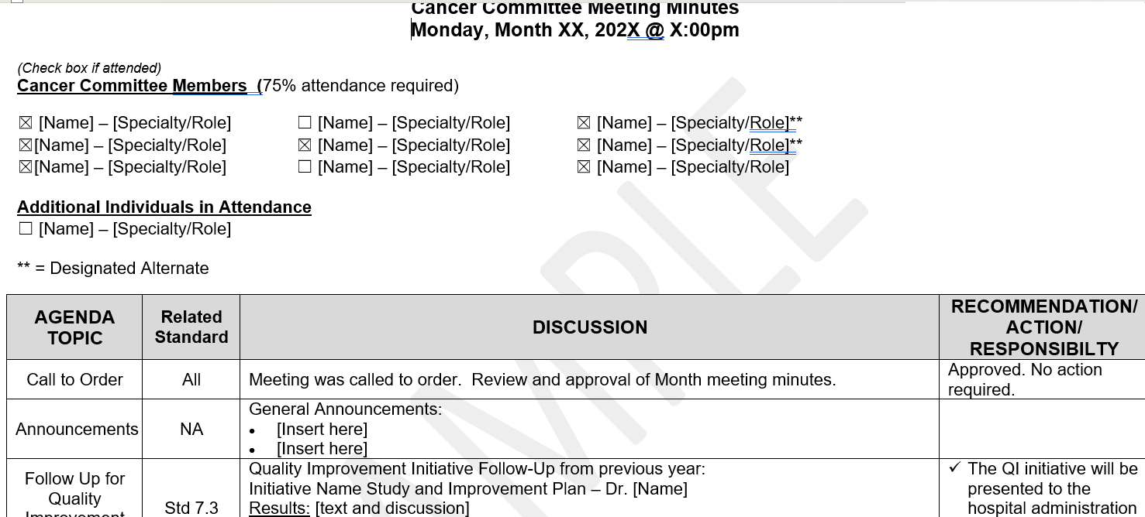
Common Pitfalls
Minutes
Why are they so important?
Template does not replace the minutes
Avoiding common errors
Keep them concise
Know what must be documented
Upload relevant attachments
Confirm embedded documents can be opened
Notes:
Minutes are the window to your program
Formal, dictated minutes not required, keep them concise
PowerPoints alone are not minutes. Minutes must be done to document discussion and action items
Review the standard, know what must be documented for each
If there is an attachment or PowerPoint that accompanies the minutes, be sure it is attached/uploaded for the site reviewer. Avoids questions prior to the site visit.
If you embed documents for leadership meetings, be sure they can accessed after uploading to the PRQ. Or be proactive and upload the documents. Do not assume the report will open for Cancer Program Staff or the Site Reviewer

Slide 17
Common Pitfalls
Definitions and Requirements
Purpose of the standard
Detailed requirements
Elements of a protocol
Elements required for annual reporting
Documentation
Materials supporting compliance with standard
Submitted with the PRQ
Reviewed on-site
Measures of Compliance
Actionable items required to meet the standard
Read the entire standard!
Know the standard requirements
Did process or protocol demonstrate understanding and compliance?
Documentation and Measure of Compliance sections not meant to replace Definition and Requirements

Slide 18
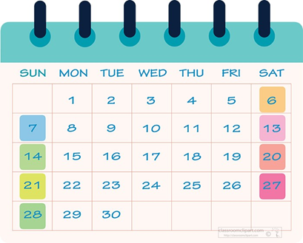
Common Pitfalls
Annual Reviews and Reports
Presented during the year of activity or Q1 of following calendar year
During the year of activity
Annual activities such as audits, projects, reports, or events
Presented to cancer committee within calendar year per frequency required in the standard
Presented after the activity has been completed
Cannot be presented in Q1 of the following calendar year
Q1 of the following calendar year
Must include full calendar year of reporting data
Reports without full calendar year of data do not meet compliance.
Must include all required elements
Some programs may choose to provide partial year reports also, but that data must be included in the final Q1 report of the following year.

Slide 19
Common Pitfalls
Annual Reviews and Reports
Some standards require annual evaluation but do not require data review.
Presented and discussed with cancer committee during the year of activity.
Presented and discussed during the Q1 of the following calendar year

Slide 20
Common Pitfalls
Protocols/Policies and Procedures
Not a restatement of the standard or guideline
Must include all required elements
Outlined in standard
Reviewed by the Cancer Committee, BPLC, or RC-MDT
Documented in the minutes
Notes:
Recommended
Title
Created/reviewed by
Created/reviewed/next dates

Slide 21
Common Pitfalls
Quality Improvement Initiatives
Common Stumbling Blocks
Identified problems have no baseline data
There is no identified problem
A QI Initiative looking to see if a problem exists does not meet compliance
Intervention must be measured, monitored and drive improvement
How do you know your intervention was successful?
Must be measurable against baseline data
Interventions may need to be adjusted
Notes:
No data was collected and used to identify the problem.
The QII starts with “the fix”. Then concludes there was no real problem to correct. This is not meeting the intent of the standard.
Missing discussion with the cancer committee.
Minutes do not reflect review and discussion of the QII.

Slide 22
Common Pitfalls
Quality Improvement Initiatives
QI initiatives must
Be data-driven
Based on an identified problem known to exist within the accredited program
A problem statement must be fully developed
Include baseline data
Demonstrate a need for improvement

Slide 23
Common Pitfalls
Quality Improvement Initiatives
Interventions implemented to drive improvement
Must be measurable
Compared against baseline data
Interventions may need to be adjusted
Did the intervention achieve its intent
If no, what needs to be adjusted

Slide 24
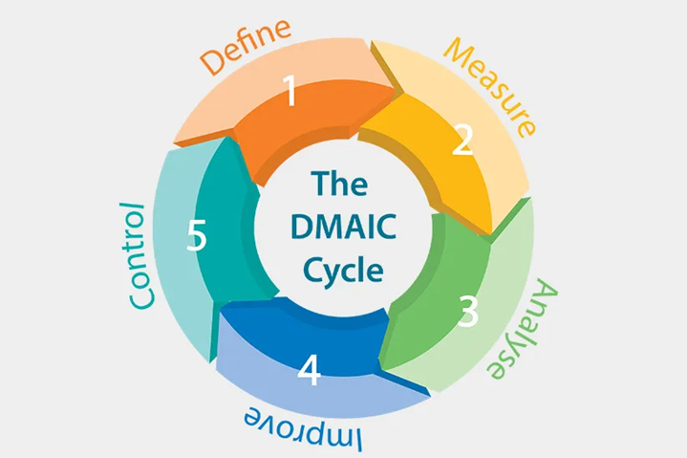
Common Pitfalls
The Structure of Quality Improvement
QI Initiative Requirements
1. Review Data to Identify the Problem
2. Write the Problem Statement
3. Choose QI Methodology and Metrics
4. Implement Intervention and Monitor Data
5. Present Quality Improvement Initiative Summary
Notes:
DMAIC is just one tool available
PDSA
ACS Quality Framework

Slide 25
Other Common Pitfalls - What To Avoid
Double Dipping
Work to obtain compliance in one CoC standard may not replace, duplicate, or augment the work required to obtain compliance with another standard
The sole exception to this rule is CoC Standard 7.3: Quality Improvement Initiative
Reports cannot be the same or like reports used to meet other standards
Example: Report satisfying the required review of Standard 4.7: Oncology Nutrition Services cannot also be used to meet the requirements of Standard 4.8
Reports for CoC Standard 2.2 cannot be used to meet CoC Standard 6.4
Consider use of RCRS Submission Report
Notes:
Recently a couple of clarifications came out regarding the use of the same cancer program activity to address more than one standard. The exception is 7.3 QII. A standard that has an outcome that also can be an identified problem for QII. There should be baseline data that sets the problem statement.
Some examples of this may include providing the same Nutrition annual report for 4.7 and as part of 4.8 services. While the staff for both may be the same, 4.7 is aimed at the patient in current treatment, while 4.8 should be directed at the survivor; those patients who have completed active treatment.
Lastly, the CLP cannot use their reporting on NCDB Tools in S2.2 to meet the criteria for Standard 6.4. The 6.4 report should be focused on RCRS submissions, including population of the Quality Measures as well as other cancer sites not addressed in the Quality Measures. There is an RCRS Submission Report that can help facilitate discussion for 6.4. Further details can be found in the RCRS/Reports section.

Slide 26
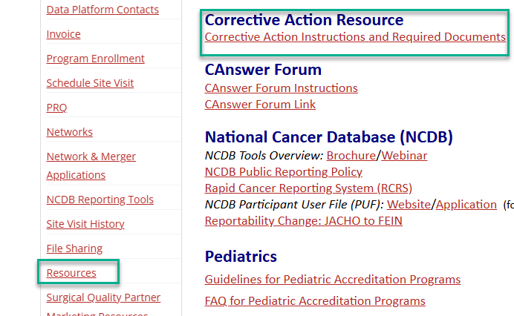
Corrective Action Documentation
Corrective action must be completed for any non-compliant standards noted in the Accreditation Report.
Corrective action documentation
Separate resource including instructions and required documents
Specific requirements for full resolution, may include:
Action Plan(s)
Annual Reporting
Audits
Minutes
Completed templates
Notes:
Be sure to review the Corrective Action Instructions and Required Document for a clear description of what is required to resolve each deficiency. Do not assume what is required.
If you were able to listen to Marci and Dr. Kruse’s presentation on Thursday, you want to be sure you follow the Corrective Action Required Document so you can fully resolve the deficiency.
The documentation may consist of Action plans, a complete year’s Annual Report, Audits and minutes reflecting the presentation and discussion of the audit findings and any additional action items that might be necessary following the audit. Corrective action may also require the completed standard templates along with minutes from Cancer Committee, BPLC or RC-MDT meetings.

Slide 27

Questions?

Slide 28
Thank you!
Karen Stachon, CPHQ kstachon@facs.org
Kalea Whitmore, MBA, BS kwhitmore@facs.org

