Slide 1

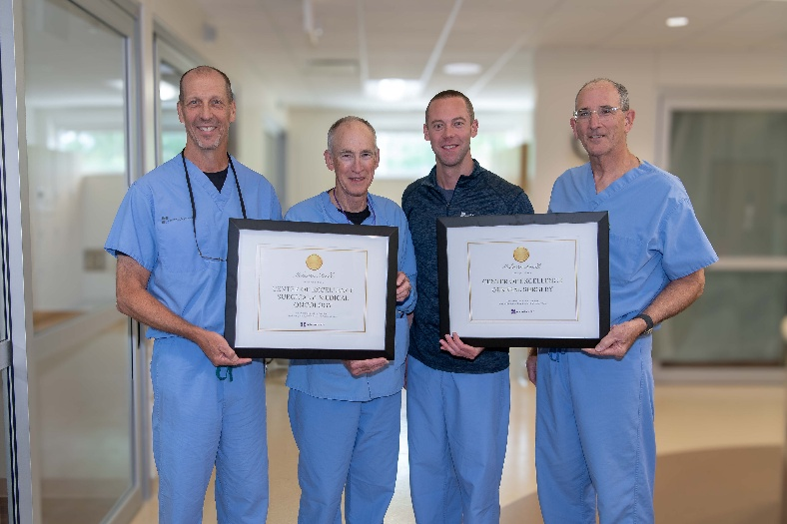
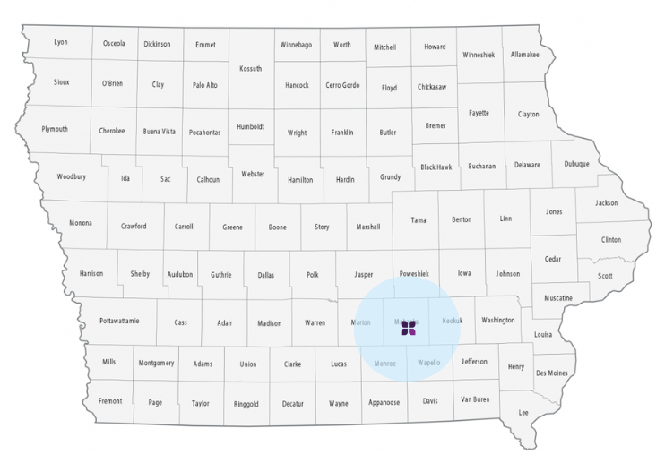
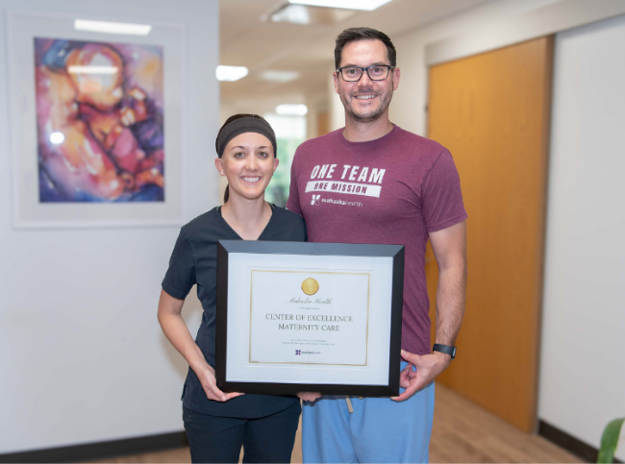
Rural Cancer Care
The Mahaska Health Journey
Oskaloosa, Iowa
86+ Medical Specialties
4 Iowa Centers of Excellence – Maternal Health & OB, Oncology,
General Surgery & Cardiology
1,655 general surgery clinic patient consultations across 28 Iowa counties and 11 out-of-state patients in 2025. Surgery Services team performed 4,093 cases in 2025 across all service lines.
49 cancer cases reviewed in 2025, through the Interdisciplinary Tumor Board, fostering collaborative treatment planning between multiple service lines locally along with specialists from Des Moines and Iowa City. The only active critical access Tumor Board in Iowa.
Physician & Nurse led hospital with 18 Medical Directors. Meet monthly with executive team.

Slide 2

Mahaska Health Overview
  Physician, Provider & Nurse led Hospital
    18 Physician Medical Directors
  693 Employees with 102 Physicians/Midlevels
  Surgeries more than doubled from 2,200 procedures to 4,300 procedures. Clinic visits increased by 14,000 patients.
  Privilege of serving a 28 counties 65,000 patient population / service area.
  If employees and physicians are happy patient volume increases, which increases margin and invest back into employees.

Slide 3
Background – My story
  Change was needed
  Exercises in self awareness
  Input from friends and mentors
  Leverage connections and relationships
  Small projects to start, building trust
  Opportunities blossom
3

Slide 4
Objective: Improve Cancer Care in SE Iowa
  Understand the ‘Why?’
  Describe our ‘How?’
  Discuss missteps and obstacles
  Foster cancer care networking across rural Iowa
4

Slide 5
Why pursue CoC accreditation?
  Improves cancer outcomes
  Increases ancillary volumes
  Spins off into other service lines
  Helps with recruitment and retention
  Builds medical staff cohesion/communication
  Builds community awareness
  Improves hospital reputation and market share (increased 10% the last 7 years with patients served from 28 counties)
5

Slide 6
Improving Cancer Care
  Data driven improvement
    Accurate staging, Timely therapy, Guideline adherence
    NCDB feedback
    Accurate staging
  Increased survival in common cancers
  Comprehensive care
    Tumor board
    Non-medical care
    Survivorship & Palliative care
6

Slide 7
Yes, there are more meetings but…
  Collaboration across specialties
    Education / Collegiality
  Build data infrastructure
    Measure, benchmark, continuous improvement
  Cost of accreditation offset by
    Improve guideline compliance
    Patient retention
    Reduced treatment variation
  Future payor issues and prior authorizations
7

Slide 8
Step 1: Look in the mirror
  What cards do you hold? What’s missing?
    Providers / Specialists
    Non provider services
    Referrals / Network
    Administration support
    Board of Trustees
    Physical plant
  Mindset
    Growth vs. Scarcity
    Win-Win vs. Zero Sum Game
8

Slide 9
Step 2: Collect outside opinions
  Iowa Cancer Registry
  American College of Radiology
  HCAHPS / CMS
  Press Ganey
  Invite feedback / advice
    Mentors
    National Societies
    Strategic Physician Planning Retreat
    Utilize Best Practices
9

Slide 10
Step 3: Build a shared vision
  Identify and survey stakeholders
  Grass roots attitude (listen)
  Set priorities
  Identify the MoJo and NoJo
10

Slide 11
Step 4: Baby steps
  Low hanging fruit (maybe to you)
  Start with the MoJos
  Communication, trust, momentum
  Use existing programs, relationships, events
  The Hawthorne effect
11

Slide 12
Examples
  ICR
  Radiology
  Screening
  Palliative Care
  Non oncology spin off
    ERAS
    Start time
  Strategic Retreat
    Top 10 Actions
12

Slide 13
Missteps or false starts
  Iowa Radiology
  CTR (ODS) training
  New physical plant (OR, Oncology & Infusion renovations)
  Alignment
    Traveling specialists
    Board vs. Hospital leadership
  Culture fit
    Moving from RVU focus
13

Slide 14
How to measure the costs?
  FTEs
    Navigation
    Palliative Care
    Survivorship
    Data Analytics
    Care Coordination
  Meetings
    Hourly rate
14

Slide 15
I-CAN
  Knowledge
  Experience
  Resources
  Templates
  Feedback
  Expectations
  Future Possibilities…
15

Slide 16
Summary
  Self-Awareness
  Vision
  Alignment
  Build Trust & Momentum
  Sins of Commission > Omission
  Mindset + Communication + Trust + Accountability
  = CULTURE
16

Slide 17
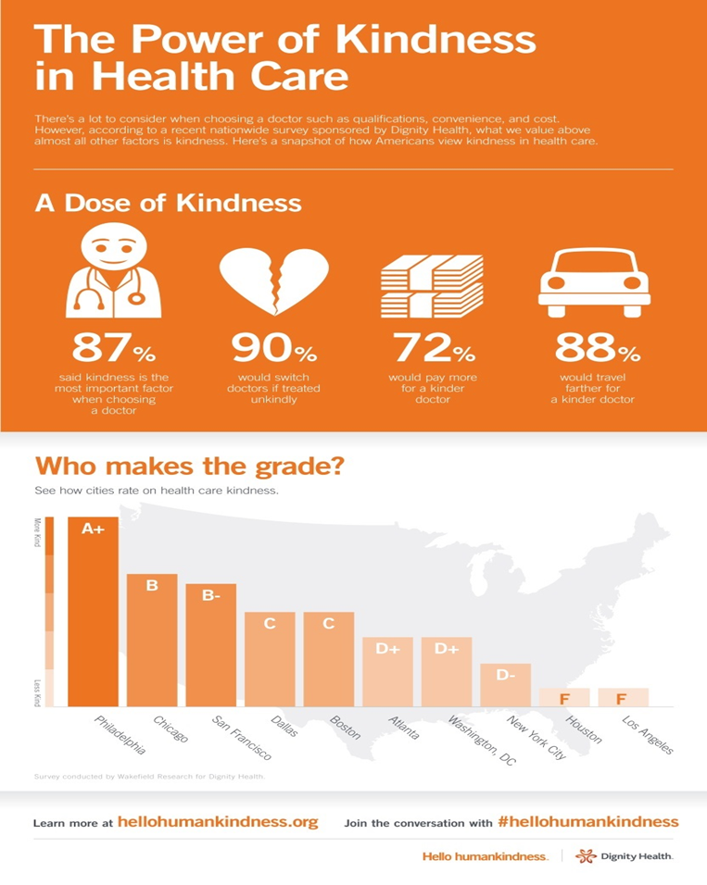
The Power of Kindness in Health Care
  Empathy & Kindness can speed the healing process and lead to better outcomes for patients and caregivers.
  Press Ganey stated that Mahaska Health is “Not Normal.” Highest Employee satisfaction ever recorded at the 96th percentile top 100 out of 4,600 healthcare systems nationwide.
  Labeled as “Not Normal?”
  “Feels Different Here” Patient Comment

Slide 18
Mahaska Health Culture
  Need to have the patience to build up a strong organization, and a strong organization starts with caring for their people
  It is amazing how much can be accomplished if no one cares who gets the credit
  Whatever you do in life, surround yourself with smart people who’ll argue with you
  Physician, Provider & Nurse led Hospital (Medical Director Meetings & Retreat)
  The Needs of The Patient Come First
  Serving is the art and act of focusing on someone else’s interest instead of your own
  Change happens at the speed of relationships
  Teamwork and love for one another and the team being more important than the individual
  Culture is everything. The result is a culture that continues to attract teammates who share the same values
  Enjoy serving at work / go home to your families, which drives passionate patient care - Compassion, Kindness, Empathy and Teamwork
  Overall Goal: Get the right people at the table and make it safe for them to share anything. Then take massive action!

Slide 19
Mahaska Health Culture Specific Initiatives
  Third Party Support – Stroudwater – Eric Shell. University of Iowa - Mary Charlton & Dr. Ingrid Lizarraga
  10-year active recruitment plan – Host Providers and Spouses during nights and weekends. Customize each visit to their needs and interests. All employees are on a retention/recruitment plan.
  Reversed the organizational chart – Teammates are all here to serve, which leads to ultimately serving our patients.
  During Covid we provided a $5 dollar an hour increase for all 200 nurses, which led to not having to employ contracted labor at $180 or $200/hr.
  Two snack carts, free Smokey Row coffee, summer food trucks, free Mahaska Health swag, free Physician/Mid-level lounge food, drinks, snacks and requested items.
  Taking Echo & Ultrasound Tech students for dinner – sharing our culture.
  Physician and Nurse Leadership. 18 Medical Directors meet Monthly and 1 Saturday Vision Retreat.
  8 Events throughout the year: Women’s Health Night, Men’s Health Tractor Ride, Cardiology Heart Month, Baby Fair, Share the Love for Hospice, 5K Run in the Sun.
  Build your Labor and Delivery program – don’t cut it. You lose moms you lose your primary care base.
    General Surgeons, OB/GYNs, FP/OBs and Midwives can all work together to care for a region of mothers and babies.

Slide 20
Cancer Services Provided
  Ear Nose & Throat w/ Head & Neck Cancer Care
  Palliative Care & Hospice
  Medical Oncology
  Surgical Oncology & General Surgery
  Urology
  Cancer Care Navigation Team
    Director of Oncology
    Care Coordinator
    2 Oncology Nurse Navigators
    Infusion Clinic Nurse Lead + 4 Nurses
    Cancer Program Coordinator
    Infusion Pharmacist
    Oncology Patient Representative
    Prior Authorization Specialist
    2 Social Workers
  Weight Loss Management
  Pain Management
  Multidisciplinary Tumor Board
  Cardiology
  In-House Retail Pharmacy
  In-House Radiology & PET/CT & Biopsy Services
  Massage Therapy
  Financial Counseling
  Nutritionists
20

Slide 21


Who has the first Question?

