Slide 1
From Tension to Teamwork: Resolving Conflict in Clinical Settings
Tippie College of Business
Professor Lon Moeller, JD
November 12, 2025

Slide 2
Today’s Presentation
Defining conflict.
Identifying the “good” and “bad” of conflict.
Reviewing different types and sources of conflict.
Discussing the type of interests present in a conflict situation.
Applying an interests-based approach to manage conflict situations in clinical settings.

Slide 3




Conflict is Like…

Slide 4

Let’s Talk about Conflict

Slide 5
Let’s Talk about Conflict
Conflict involves disagreements over resources, and value differences between people and groups that rely on each other.
Conflict can be caused by relationship differences between people (different values and experiences), or task differences (how work is done or how decisions are made – cognitive conflict).

Slide 6
The Causes/Sources of Conflict
Identity-Related Differences: Different backgrounds, experiences, cultural values, levels of education, etc. (Different perceptions and personal styles)
Role Incompatibility: Work tasks “are interdependent” but “roles are incompatible” (Different agendas)
Environmental Stress: Limited resources, rapid technological change, evolving regulatory environment, etc.

Slide 7
Let’s Talk about Conflict (Continued)
Conflict can generate intense, negative emotions (anger and frustration) (affective conflict).
Conflict causes us to look at our differences, instead of what we have in common. Our communication becomes less direct and more inaccurate in a conflict situation.

Slide 8
Let’s Talk about Conflict (Continued)
Most conflict situations lead to a “attack/defend spiral,” because people focus on their own concerns and why they are “right” instead of trying to understand the other person’s concerns.
Unmanaged conflict can lead to significant costs and negative consequences (the “bad” of conflict).
Notes:
Note: Coleman comments in “The Conflict-Intelligent Leader,” Harvard Business Review (July-August 2025), “contentious interactions at work are estimated to cost businesses more than $2 billion a day in productivity losses and absenteeism.”

Slide 9
Types of Conflict
Intrapersonal: Working late vs. watching a child’s music concert
Interpersonal: Conflict driven by different experiences, values and interests
Intergroup: Battle between organizational departments over limited resources
Intragroup: Disputes between members of the same team, organization, etc.

Slide 10
Let’s Talk about Conflict (Continued)
Conflict is inevitable. The question is not if conflict exists, but how will we respond to the conflict when it occurs.
Conflict that is identified and effectively managed can lead to positive results, increased innovation and creativity, stronger and resilient relationships and improved decision-making and problem-solving (the “good” of conflict).
Notes:
Note: In “How to Master Conflict Resolution,” Harvard Business Review (October 21, 2024), Gallo states, “[w]orkplace conflict is a normal, inevitable part of interacting with other people.” Garvin and Roberto write in “What you Don’t Know About Making Decisions,” Harvard Business Review (September 2001), “[c]ritical thinking and rigorous debate invariably lead to conflict. The good news is that conflict brings issues into focus, allowing leaders to make more informed choices. The bad news is that the wrong kind of conflict can derail the decision-making process altogether.” Gavin and Roberto also distinguish between “cognitive conflict” – conflict involving “disagreements over ideas and assumptions and differing views on how to best proceed” – and affective conflict – the emotional response to conflict – conflict over “personal friction, rivalries, and clashing personalities.”

Slide 11
Conflict Resolution Skills are Critical for Leadership/Managerial Success
Conflict is an organizational reality that can be both destructive, and “play a productive role both within a person and between persons.”
It is estimated managers spend 20% of their time managing conflict.
Although there are a variety of reasons for conflict, inadequate communication and perceived inequities (fairness) are frequent sources of conflict in an organization.
Good “common sense” is not enough to resolve conflict – training and a strategy is critical to conflict resolution.
Notes:
Source: “Managing Interpersonal Conflict,” Harvard Business School Note (November 20, 1985) (“The ability to productively manage…conflict is critical to managerial success”).. In “The Conflict Resolution Skills Every Project Manager Needs,” Harvard Business Review (October 20, 2023), Davey emphasizes that a great project manager needs to be a skilled and “respected conflict manager.” According to Davey, effective project managers must develop skills to (1) expose tensions and trade-offs, (2) establish a productive conflict dynamic, (3) solicit dissent and facilitate conflict, (4) manage friction, and (5) influence those with power. In “To Resolve a Conflict, First Decide: Is it Hot or Cold?” Harvard Business Review (June 26, 2014), Gerzon notes, “your ability to navigate conflict is one of the primary ways you reveal your character as a leader.” Likewise, Williams writes in “Don’t Avoid Conflicts – Manage Them,” Harvard Management Update, (July 1997), “negotiating conflict is more fundamental to the work of the manager than ever.” Conflict resolution skills include things like how to create psychological safety, perspective-taking, listening for underlying needs, empathy and cultivating trust. Lastly, Harroch notes in “Qualities of the Best and Worst Managers: Lessons I’ve Learned,” forbes.com (September 7, 2024): “Effective conflict resolution is a critical management skill because your success and satisfaction as a manager are directly tied to the success and happiness of your team.”

Slide 12
“Myths” About Conflict
People who disagree with us do so because they are uniformed or unintelligent.
  We tend to focus on the facts that support our position and dismiss the facts that do not support our position.
  We rely on our past experiences and “preconceived notions.”
Disagreement will make people defensive.
  We assume the other person is angry and feeling insecure.
  We tend to “avoid the hard work of trying to understand the other.”
Disagreement is bad.
  “Disagreement, when managed well, gets greater results than avoidance does.”
  We assume the other person “won’t listen with an open mind.”
Notes:
Source: Minson and Gino, “Managing a Polarized Workforce,” Harvard Business Review (March-April 2022).

Slide 13
Why do we Avoid Difficult Conversations (Conflict)?
It estimated that 70% of employees avoid having difficult conversations with their bosses, co-workers and direct reports.
Many leaders want to “be liked,” and avoid dealing with conflict situations to “keep the peace,” and maintain harmony in the workplace.
The tendency of some leaders to ignore or avoid conflict can create an organizational culture – a “culture of nice” – that minimizes the value of “straight talk” and constructive feedback.
Notes:
Sources: Bravely, “Understanding the Conversation Gap: Why Employees Aren’t Talking, and What we Can do About it,” https://learn.workbravely.com/hubfs/Understanding-the-Conversation-Gap.pdf and Argyris, “Skilled Incompetence,” Harvard Business Review (September – October 1986). Also, Glenn Llopis writes in “4 Ways Leaders Effectively Manage Employee Conflict,” forbes.com (November 28, 2014), that “[l]eaders must act responsibly to be respected,” and “[a] leader must be expected to neutralize or minimize conflict, not allow it to grow and run rampant.” He suggests four ways that a leader can deal with workplace conflict (1) right timing - “the best time to take action is when there is hard evidence/proof that an employee has a track record of wrongdoing that is negatively impacting the performance of others,” (2) know your boundaries - a leader must understand the boundaries and limitations of the members of a team, (3) respect differences -appreciate the fact that the members of your team have different points of view, and (4) confront the tension – “activate your leadership to address the conflict before circumstances force your hand.”

Slide 14
Managing Workplace Conflict
You need to recognize the type of conflict situation in front of you (root cause)
You need to be patient:
  Consider your psychological filters (cognitive biases)
  Identify what people want/need (interests)
  Establish rapport (personal connection)
You need to have good imagination
  Identify possible solutions
  Understand each person’s “world of rationality”
Notes:
Note: Minson, Collins and Yeomans emphasize in “A Smarter Way to Disagree,” Harvard Business Review (November – December 2025), the value of being curious (and having a good imagination) when dealing with conflict – “conflict outcomes improve quite dramatically when people express their willingness to learn about their counterpart’s opposing perspective.” They also note people in conflict situations “assume that their counterparts don’t want to learn about their perspective or understand their views,” as “[t]he simplest way to signal curiosity is just to say you are curious.” Likewise, in “How to Master Conflict Resolution,” Harvard Business Review (October 21, 2024), Gallo recommends leaders approach a conflict situation by first trying to see the conflict situation from the other person’s perspective (“What do they care about,?” “What’s causing them to behave the way they are,?” and “What do they want?”), identify what the conflict is “really about,” determine your primary goal, and decide how to proceed.

Slide 15
Why is it Difficult to Determine what Other People Want?
They may not trust you enough to tell you what they want.
They may see the world differently than you do.
They may not know or be able to clearly identify what they want.

Slide 16
Understanding What People Want
The psychological filters (cognitive biases) we use to quickly process information in a conflict situation make it difficult for us to determine what people want.
Recognizing these filters and understanding how they affect your ability to process information will help you better identify what people want and need to resolve a conflict situation.

Slide 17
Psychological Filters
“I know better”
“It’s not my fault”
“Get rid of the problem, and quickly”
“What I said, isn’t what I meant”
“They are completely irrational”
“Don’t rock the boat”

Slide 18
What are Interests?
“Interests” are the underlying reasons for what people in a conflict situation say they want or need.
People in a conflict situation are not always clear about what they say they want.
Psychological filters may lead people in a conflict situation to inaccurately say what they want or need – their interests.

Slide 19
Types of Interests
Tangible interests
Intangible interests
Relationship-based
Process-based
Notes:
Note: In negotiations we frequently talk about the difference between a position (which is a specific proposal or “ask” in negotiation) and an interest, which is the underlying reason for the position. Positions are singular while interests can be multiple.
We sometimes describe a tangible interest as something you can touch, see, hear smell and taste. Specifically, a tangible interest is something with a measurable and discreet outcome (money, physical resources, time, a particular transaction or result, etc.). Relationship-based intangible interest include things such as being respected, recognized for doing a “good job,” being appreciated, feeling valued, etc. Process-based intangible interests pertain to how something is done, or how a negotiation is conducted, or how a dispute resolved. For example, a concern about setting a precedent by doing something a new way or doing something in a way that is inconsistent with the ways things have been done in the past. “Researchers have found that if participants believe the process was fair, they are far more willing to commit themselves to the resulting decision even if their views did not prevail” (Garvin and Roberto, “What you Don’t Know About Making Decisions,” Harvard Business Review (September 2001).
Because tangible interests can be easily detected, we naturally focus more on them and overlook significant intangible interests. Intangible interests, however, tend to be the interests that drive positive behavior – “When staff feel noticed, valued, and respected, they are more willing to help each other, collaborate and solve problems,” Macklin, Lee and Edmonson, “Why Kindness isn’t Nice to Have,” Harvard Business Review (July 29, 2025).

Slide 20
How can we Know what Other People Want?
Conflict management requires an understanding of the different interests present in the conflict situation.
It is sometimes difficult to identify interests (theirs and ours) because of the way we use our pre-existing thoughts and assumptions to process information (cognitive bias and filters).
Notes:
Note: We use simplifying rules to process information in a conflict situation; however, these rules are often based on biases we have established – “the better than average effect,” “confirmation bias,” “attribution bias,” etc. (“I know better,” “Get rid of the Problem, and Quickly,” “It’s not my Fault,” “What I said isn’t what I meant,” “They are Completely Irrational,” and “Don’t Rock the Boat.”).

Slide 21
Identifying what People Want - Guidelines
Be patient and demonstrate that the other person’s time is important to you.
Ask “why” questions to better understand the other person’s interests. Think about how your psychological filters may affect what you hear and identify the type of interests (tangible and intangible) reported by the other person.
Be genuinely interested in what the other person has to say and pay attention to their actions (watch body language).
Be empathetic – try to understand things from the other person’s perspective.

Slide 22
Examples of Conflict Situations in Clinical Settings (Application)

Slide 23
Conflict Situations in Clinical Settings
Patient care is delivered through interdependent teams of health care professionals. The patient experience is affected by how well the teams work together.
Different generations (Baby Boomers, Gen X, Millennials and Gen Z) may have value differences and different expectations about their work experiences.
While tangible interests (compensation, flexible work schedules, etc.) are important, intangible interests (respect, recognition and the opportunity to “be heard”) may be more important in terms of staff retention, building a safety culture and patient care.
Notes:
Sources: Press Ganey, “Nurse experience 2025” (Nurses who report “high levels of teamwork consistently perform better on critical patient outcomes, including falls, catheter-associated urinary tract infections, centralized line-associated bloodstream infections and pressure injuries.” Likewise, staff that feel “psychologically safe” to raise concerns “communicate more openly, collaborate more effectively and deliver better care.” Press Ganey “Patient experience 2025”: “When patients feel their care team is working seamlessly on their behalf, they’re more likely to give high ratings on their care and recommend the hospital to others.”

Slide 24
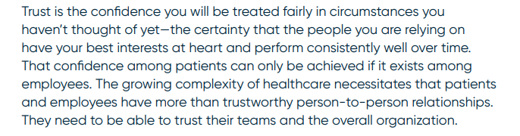
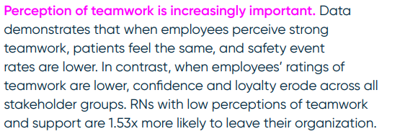
Conflict Situations in Clinical Settings (Continued)
Notes:
Source: Press Ganey, “Healthcare employee experience 2025.”

Slide 25
Taking an Interests-Based Approach to Effectively Manage Conflict
Identify the sources and types of conflict.
Establish rapport (a personal connection) with the other person(s).
Determine the interests of the individuals involved in the conflict situation.
Engage individuals in clarifying interests and finding joint solutions (through negotiation or mediation).
Build support for and implement an agreed-upon solution.

Slide 26



Conflict Management Case Studies

Slide 27
Thank you. What Questions do you Have?

Slide 28
Additional/Review Slides and Notes

Slide 29
Conflict “Triggers”
Studies suggest most of the conflict handled by first-time managers is caused by four triggers:
  Communication differences;
  Opaque performance standards;
  Unreasonable time constraints; and
  Unclear expectations leading to missed deadlines
Notes:
Source: Laker and Pereira, “4 Triggers Cause the Majority of Team Conflicts,” Harvard Business Review (May 31, 2022). Also, in “Resolving Conflict in the Workplace – and Why Common Sense isn’t Enough,” forbes.com (December 21 2023), Leonsky interviews a conflict management practitioner (Richard Birke, VP and Executive Director of the JAMS Institute) and identifies two frequent sources of conflict – inadequate communication between members of say a project team – “People usually aren’t communicating at their best when conflict arises, which can lead to a spiral that manifests in a wide variety of disputes – from yelling, to quiet quitting to actual quitting,” – and perceived inequities – based on personal characteristics, benefits/salary, workload, etc.

Slide 30
Common Types of Team Conflict
The sole dissenter – Conflict surrounds one person on the team (ask questions to understand the dissenter’s perspective – intervene one-on-one).
The boxing match – Conflict between two members on the team who disagree (most common; mediate with both to vent and understand perspectives).
Warring factions – Conflict between two subgroups on the team that disagree with each other (work to identify new alternatives/ideas that link the interests of both groups).
The blame game – Conflict engulfs the whole team – everyone on the team disagrees (revisit the goals or vision for the team).
Notes:
Source: Peterson, Shah, Ferguson and Jones, “4 Common Types of Team Conflict – and How to Resolve Them,” Harvard Business Review (May 7, 2024). Empathy and “perspective taking” are important to understand another person’s position or perspective. According to Peterson, Shah, Ferguson and Jones, “There are two key points managers and team leaders should remember. First, tackle conflict at its point of origin according to the [type of team conflict]. Save those team-building retreats for conflict that involves all team members where the whole group unity is needed. Second, take care of conflict’s ‘sides.’”

Slide 31

Difficult Conversations
“When we have to deliver a difficult message, we tend to want to sugar coat it. But even coated with sugar, a hand grenade is still going to do damage; and avoiding or choosing not to deliver a difficult message is like hanging on to a hand grenade once you’ve pulled the pin.”
Douglas Stone
Notes:
Source: Stone and Christensen, “Difficult Conversations: How to Address What Matters Most,” Rotman Magazine (Spring 2011).

Slide 32
Why do we Avoid Difficult Conversations?
“We often avoid difficult situations in conversations because we think that they won’t be productive, that we won’t be able to convince the other party to come around to our point of view. Because we start with this kind of win-lose perspective (and don’t want to lose), we seek ways around the confrontation and often end up causing more damage…”
“The truth is that managers and employees avoid all kinds of tough situations, rationalizing their actions along the way, and end up making tensions worse.”
“Avoidance is so common that there’s no panacea for overcoming it. Perhaps the best we can do is become more aware of our tendency to rationalize it and practice dealing with tough situations, so we feel more prepared when they arise.”
Notes:
Source: Ashkenas, “Even Experienced Executives Avoid Conflict,” Harvard Business Review (March 8, 2016).

Slide 33
General Observations About Difficult Conversations
A difficult conversation is a conversation between two or more people in which they have different opinions and strong emotions about high stake issues.
“[D]on’t let your main goal be to change the other person’s mind. Instead, encourage the sharing of ideas and listen before responding.”
“Conversations work best when you come in with a combination of confidence and humility” – “you don’t have a monopoly on the truth and new information might modify your perspective.”
“Be direct and avoid mixed messages” – Rehearse what you are going to say, “confidently convey the information,” and make direct eye contact.
Notes:
Sources: Stone and Christensen, “Difficult Conversations: How to Address What Matters Most,” Rotman Management Magazine (Spring 2011), Grenny, Patterson, McMillan, Switzer and Gregory, Crucial Conversations, 3rd Edition (McGraw-Hill, 2022), Grenny, “How to Respectfully Discuss Contentious Issues at Work,” Harvard Business Review (February 23, 2022), and Gallo, “How to Deliver Bad News to Your Employees,” Harvard Business Review (March 30, 2015).

Slide 34
General Observations About Difficult Conversations (Continued)
Explain how the decision was made – employees frequently seek “procedural fairness” – knowledge that “the decision-making process was sound.”
“Give bad news upfront.”
Allow for venting, not debate.
Focus on the future – “Now how do we make this best work given the concerns you have?”
Give “the person a head’s up about what you’re going to talk about.”
Be present (focus your attention on the conversation), “listen more” (with curiosity) and be open-minded.
Gather the facts – “the facts and premises that led you to your conclusions.”
Notes:
Sources: Gallo, “How to Deliver Bad News to Your Employees,” Harvard Business Review (March 30, 2015), Seppala and Stevenson, “In a Difficult Conversation, Listen More Than you Talk,” Harvard Business Review (February 9, 2017), Grenny, “4 Things to do Before a Tough Conversation,” Harvard Business Review (January 22, 2019), and Dowling, “7 Tips for Difficult Conversations,” Harvard Business Review (March 11, 2009). Davey notes in “A Game Plan for That Conversation You’ve Been Putting Off,” Harvard Business Review (April 12, 2017), “[i]n the majority of situations, you should have the difficult conversation as quickly as possible,” and “[c]arrying an issue without resolution is like carrying debt. You’ll eventually have to buy the principal (by having the difficult conversation), but the longer you wait, the more interest you’ll pay in anxiety and dread.”

Slide 35
Handling Difficult Conversations
Change your mindset: Think about a difficult conversation as providing an opportunity to improve the relationship with the other person, improve things like patient care/work performance, etc.
Breathe: Take a break to collect your thoughts, take regular breaks throughout the day to practice “mindful breathing.”
Plan but don’t script: Plan for different responses to be adaptable for the situation.
Acknowledge your counterpart’s perspective: Show you care and “[e]xpress your interest in understanding how the other person feels.”
Notes:
Source: Knight, “How to Handle Difficult Conversations at Work,” Harvard Business Review (January 9, 2015). In “How to Mentally Prepare for a Difficult Conversation,” Harvard Business Review (April 4, 2016), Gallo additionally suggests that you try to stay calm when delivering a difficult message, and that you do so by “checking your mindset” (frame the difficult conversation as a an opportunity to learn and to come up with a creative solution), and that you “vent” before the “difficult conversation” – “find a trusted colleague or a spouse or friend who can listen to you complain” about the situation before you have the meeting.

Slide 36
Handling Difficult Conversations (Continued)
Be compassionate: “[Y]ou can manage to deliver difficult news in a courageous, honest, fair way” – don’t ask your counterpart to have sympathy for you” (e.g., “This is really hard for me”).
Slow down and listen: Slow your speaking cadence and pause before responding.
Give something back: Propose options or “next steps” after delivering difficult news.
Reflect and learn: After the fact, “consider what went well and what didn’t.”
Notes:
Source: Knight, “How to Handle Difficult Conversations at Work,” Harvard Business Review (January 9, 2015).

Slide 37
Psychological Filters (Cognitive Biases)
Psychological filters (cognitive biases) are short cuts we use to process information when faced with making decisions in a conflict situation. We have difficulties processing information that is contradictory to our beliefs and understandings.
Attribution bias occurs when we attribute a person’s behavior in a conflict situation to their personal characteristics (they are selfish, they are irrational, they are not prepared) rather than situational factors (the conflict is created by limited resources or by inconsistent directions, poor leadership or lack of training). By contrast, we tend to attribute problems or conflict to factors outside of our control – the situational factors we ignore when looking at the other person in a conflict situation.
Notes:
Source: Raines, Conflict Management and Leadership for Managers, Third Edition (Rowman and Littlefield, 2024), pp 76-77.

Slide 38
“It’s not my Fault” and the “Blame Game”
When making judgments about other people we tend to attribute aspects of their behavior to “internal characteristics” – they are lazy, they have a bad attitude, etc. – instead of factors beyond their control – lack of training, lack of resources, etc. (fundamental attribution error).
“The common tendency to blame others for problems that we would never blame ourselves for can lead managers to assume that they are managing difficult employees – and employees to assume they are being led by difficult people.”
Notes:
Sources: Shonk, “Managing Difficult Employees, and Those who Just Seem Difficult,” Harvard Program on Negotiation (January 9, 2025) and Shonk, “Elements of Conflict: Diagnose What’s Gone Wrong,” Harvard Program on Negotiation (January 13, 2025) (“…due to the fundamental attribution error, a persuasive human tendency, when things go wrong in our lives, we often blame factors outside of our control, but when things go wrong for others, we tend to blame fundamental aspects of their character.”).

Slide 39
Psychological Filters (Cognitive Biases) (Continued)
We process information in a conflict situation through psychological filters (cognitive biases); however, “our preexisting biases drive us to interpret facts incorrectly or jump to conclusions prematurely.”
Conformation bias occurs when we look for facts to support our beliefs, and discount contrary facts – the basis of the “they are completely irrational” psychological filter.
Overconfidence bias is reflective of the “better than average effect and the “I know better” psychological filter – causes us situation to overestimate our ability to identify the sources of conflict and to resolve a conflict situation.
Representativeness bias suggests current events are evaluated on the basis of “stereotypes or similar occurrences” in the past (“Get rid of the problem, and quickly” psychological filter)
Notes:
Sources: Raines, Conflict Management and Leadership for Managers, Third Edition (Rowman and Littlefield, 2024), pp. 77-79, and Gary, “Cognitive Bias: Systematic Errors in Decision Making,” Harvard Management Update (April 1998).

Slide 40
Practical Tips for Dealing with Difficult People in the Workplace
Understand their perspective (empathy = “the ability to understand and share the feelings of others”)
Practice active listening
Use assertive communication – state “your needs clearly and respectfully. Don’t shy away from expressing your feelings but do so in a way that respects the other person’s rights and feelings.”
Create boundaries - “[l]et them know what behavior you find unacceptable and what the consequences will be if they cross these limits.”
Show kindness
Seek assistance when necessary
Stay professional
Choose your battles wisely
Notes:
Source: Fey, “8 Practical Tips to Deal with Difficult People in the Workplace,” DM News (April 27, 2025).

Slide 41
Tangible vs. Intangible Interests
  Tangible:
    Tangible measurable outcomes (money, physical resources, time, transactions costs)
  Intangible:
    Perceptions of trust, fairness, desire for participation, respect, self identity, sense of independence, sense of community, avoidance to take responsibility (relationship issues)
    The way the dispute is to be resolved, or the way decisions should be made or will be made if the problem is not settled (process issues)
Notes:
Note: As Gallo states in The HBR Guide to Dealing with Conflict (2017), “[t]he essence of a resolution is that you get to what the underlying interests are and to satisfy as many of those interests as possible,” that is, to find “[a]n agreement that satisfies as many interests as possible, is fair and reasonable and keeps the relationship in tact.”).

Slide 42
Positions v. Interests
When people in conflict situations tell you what they want it often is a particular position or general issue:
  “I want $10,000.”
  “I want that person fired”
  “She is trying to sabotage this project”
From positions you need to identify the interests.
Interests are underlying needs and are defined by individual perceptions of the conflict situation.
Individuals won’t always want (or be able) to tell you what their interests are.
People tend to minimize other people’s interests – “It’s all about money.”
Notes:
Note: Gallo, HBR Guide to Dealing with Conflict (2017) makes the following comment: “Don’t just take what people tell you at face value – listen and ask them more questions.”

Slide 43
“Interest-Focused” Questions
Why do you want that?
Why is that important to you?
What about this situation is most concerning to you?
What leads you to believe that?
Notes:
Note: A common mistake in conflict situations is to assume that what people say they want is what they really want. A person’s expressed wants may be surrogates for other unspoken underlying interests. Always ask “why” when you think you have identified an interest.

Slide 44
Questions to Draw out the Other Person’s Perspective
“What about this situation is most troubling to you?”
“What’s most important to you?”
“Can you help me understand what you are thinking here?”
“Can you tell me more about that?”
“What leads you to believe that?”
“What would you like to see happen?”
“If this was completely in your control, how would you handle it?”
Notes:
Source: Gallo, HBR Guide to Dealing with Conflict (2017), p. 87. Also, in Gerzon, Leading Through Conflict: How Successful Leaders Transform Differences into Opportunities (Harvard Business School Press, 2006), p. 136, leaders are reminded that this is a process of inquiry and not interrogation, and “Be sure you are inquiring to learn, not to prove yourself right, Hold your own thoughts and judgments lightly, When you are not sure you understand, check it out, [and] To draw out someone’s reasoning and underlying assumptions, ask open-ended, non-directive questions (Do you have a different view What led you to think that?”).

Slide 45
Words that Demonstrate your Willingness to Listen
Hedge your claims – “I think it’s possible that…”
Emphasize areas of agreement – “We both want this hospital to operate more efficiently” or “We are both concerned about X.”
Acknowledge other perspectives – “I understand you believe…”
Reframe your ideas in positive terms – “It is important that people get vaccinated so that we all can be safe from Covid,” instead of “If people don’t get vaccinated, we will never be safe.”
Notes:
Source: Minson and Gino, “Managing a Polarized Workforce,” Harvard Business Review (March-April 2022). Also, in “3 Steps for Navigating Disputes,” Inc.com (May 23, 2024), Pryor suggests when you feel attacked or offended by someone’s comments, “take a beat” (that is, “give yourself a moment before reacting”), and be “ostentatiously curious” (meaning “[t]ake a moment to slowly reflect, journal, or talk out the situation with a friend…get externally curious about why the person said or did what they did.”).

Slide 46
What is Rapport?
“Rapport” means building a sincere, trusting and respectful working relationship with the other person in a conflict situation.
Rapport allows for the sharing of information, builds trust, reduces misunderstandings and improves compliance with any agreement reached.
Rapport is a genuine and authentic personal connection.

Slide 47
Creating a “Bubble of Rapport”
Your focus is on genuinely understanding what the other person has to say – be sincerely attentive.
Watch your physical proximity, ask questions, take notes, maintain direct eye contact, lean forward, paraphrase what you hear and match the other person’s gestures, posture and voice tone.
Use silence and pauses to draw out more information from the other person.
Notes:
Note: Former CIA Intelligence Analyst Christina Hillsberg writes in “5 Techniques to Build Rapport with Your Colleagues,” Harvard Business Review (September 30, 2021), “[w[hen you’re building rapport with someone, remember that by and large, people like to talk about themselves and their own interests.”

Slide 48
Rapport is Critical in Highly Emotional Conflict Situations
Anger, anxiety, disappointment and frustration triggered by not being heard or understood.
Strong intense emotions – defend/attack and “flight or flight.”
Productive communication occurs when underlying concerns are heard and the intensity of the other person’s emotions are recognized.
People want a constructive response to their strong statements/intensity of their emotions.
Notes:
Note: In “Calming your Brain During Conflict,” Harvard Business Review (December 22, 2015), Diane Musho Hamilton talks about the physiological responses we have to stress and conflict situations (“increased heart rate or sweaty palms,” shallow and rapid breathing, clenched jaw, muscle tenseness, “untrustworthy memory” disorientation, the lack of “complex decision-making,” etc.). In An Interest-Based Approach to Resolving and Preventing Conflict, Christensen-Szalanski and Moeller write, “[a] strongly expressed emotion signals an important underlying interest. The more important the interest is to the person, the stronger the emotional reaction when that interest is threatened.”

Slide 49
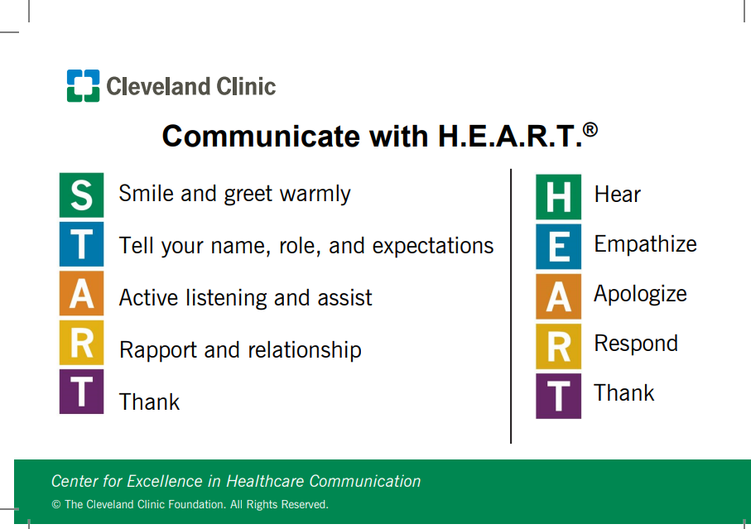
Notes:
Source: Cleveland Clinic, “Communicate with H.E.A.R.T.” program (https://my.clevelandclinic.org/departments/patient-experience/depts/experience-partners)

Slide 50
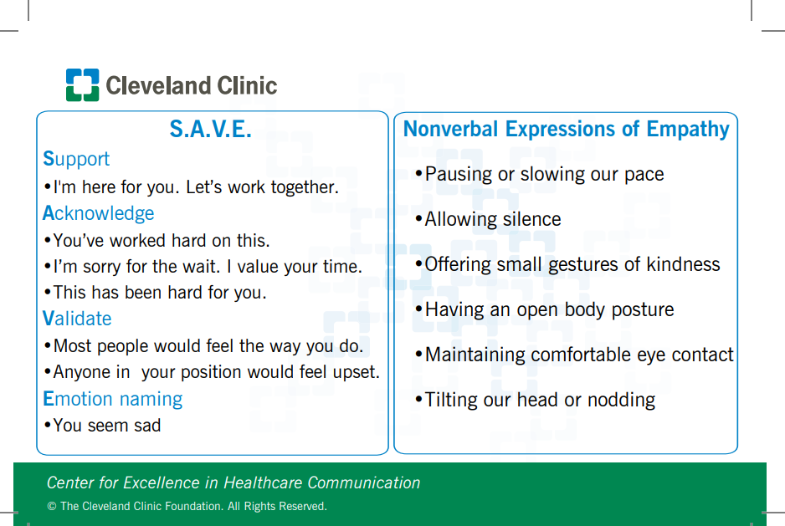
Notes:
Source: Cleveland Clinic, “Communicate with H.E.A.R.T.” program (https://my.clevelandclinic.org/departments/patient-experience/depts/experience-partners)

Slide 51
Mediating Conflict Situations
Stay neutral and collect information:
  Separate the parties to identify issues
  Let them vent if necessary
Act to (re)build trust:
  Remain neutral, even if you sympathize with one side
  Prevent insults/insist parties demonstrate respect
  Articulate common interests and goals
  Make and insist on follow through for small agreements

Slide 52
Mediating Conflict Situations (Continued)
Identify contributions vs. placing blame:
  Blame = fault
  Contributions = conditions creating problem (no fault)
Work toward creative and viable solutions:
  All parties need to have input and support agreements
  Avoid imposing resolutions
Set follow-up dates and actions if needed

